Slide 1

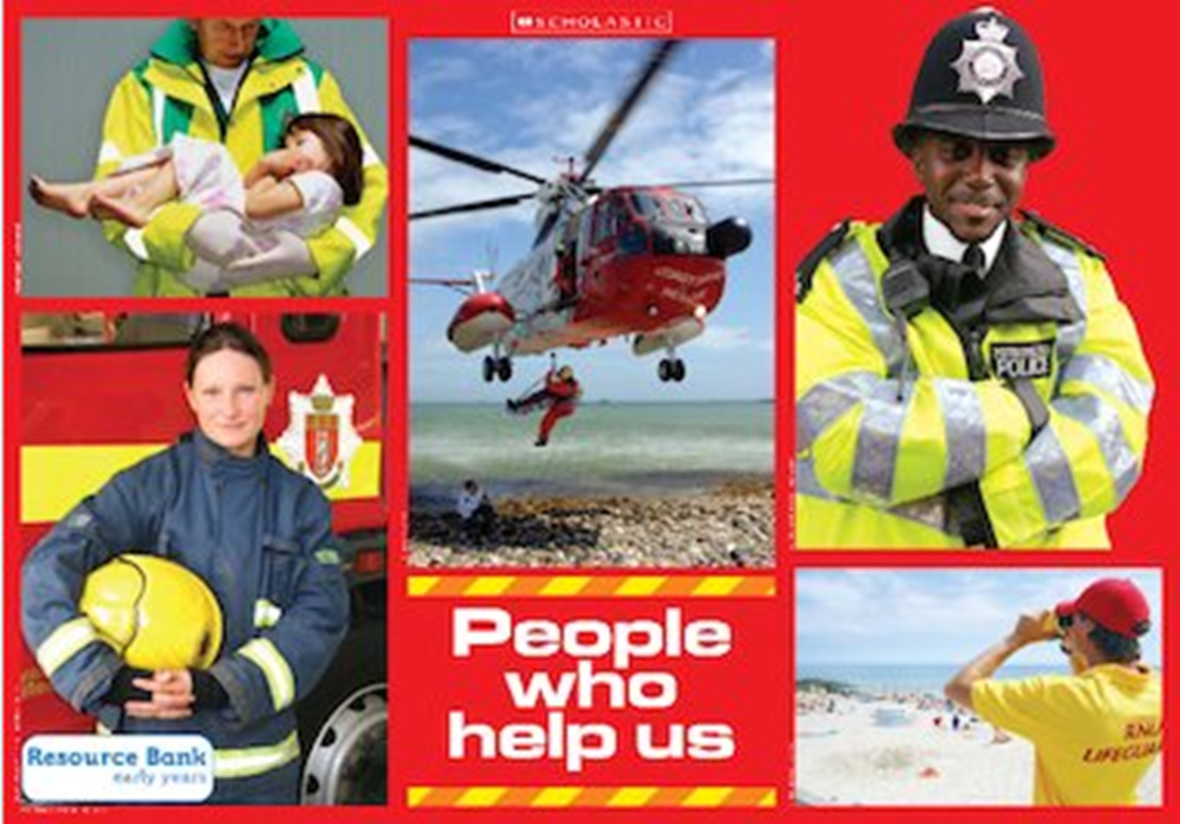
People who Help

Slide 2
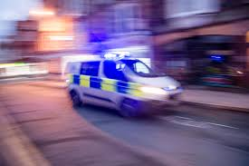
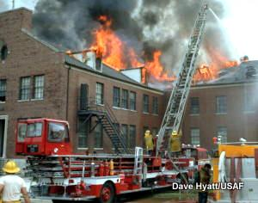
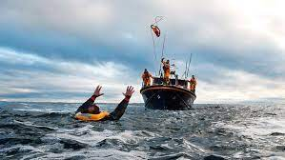
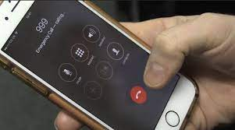
Emergency
An emergency is when someone needs help right away because of an injury or danger
Call 999

Slide 3
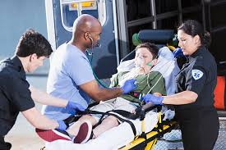
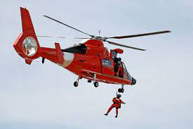
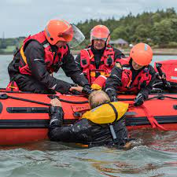
Rescue
Save somebody from a dangerous or difficult situation

Slide 4
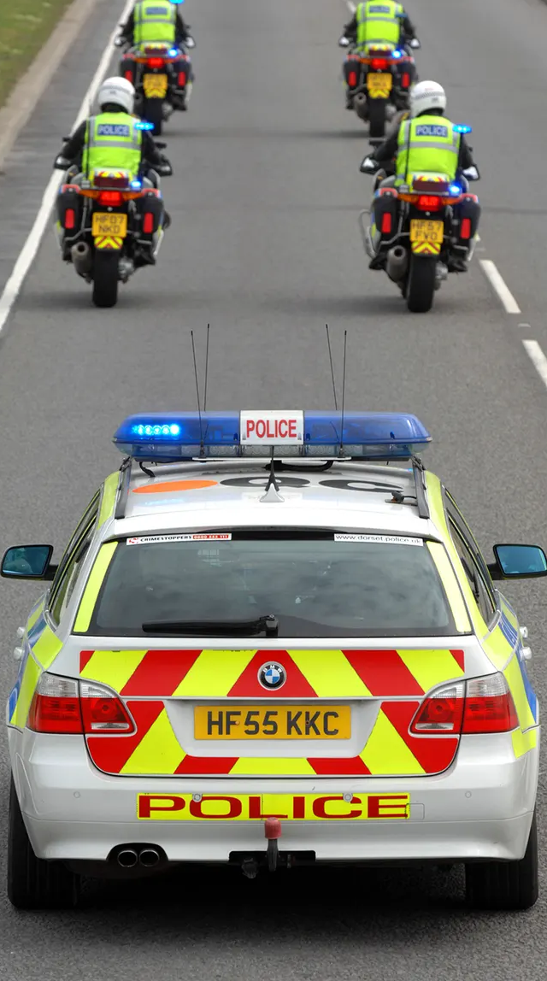
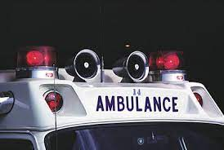
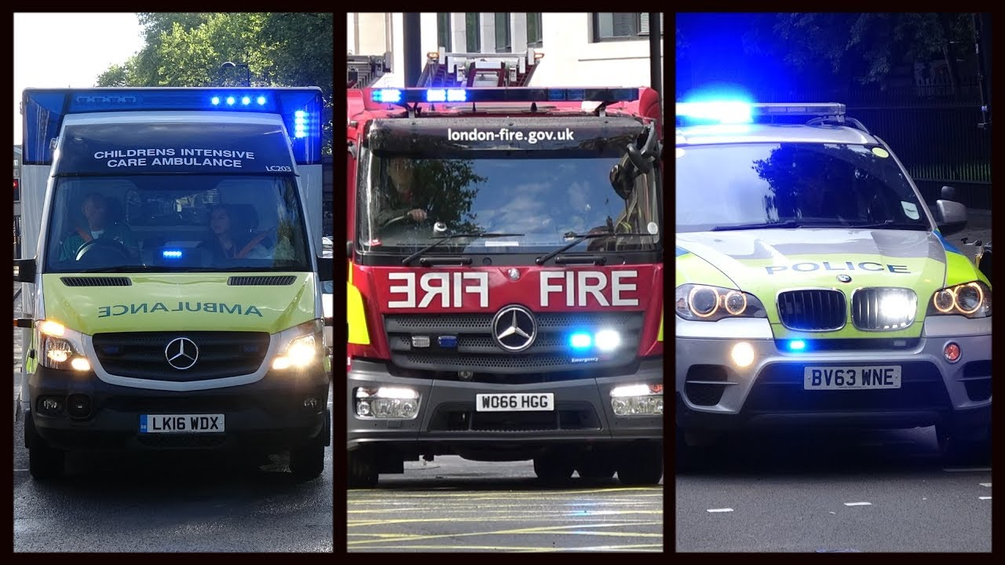
Siren
A siren is a loud warning sound made
by emergency vehicles

Slide 5
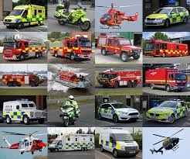
Vehicle
Something used to carry and move people or things

Slide 6
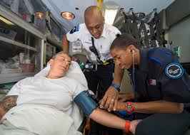
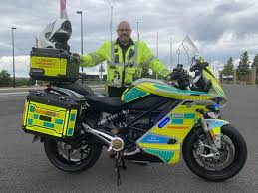
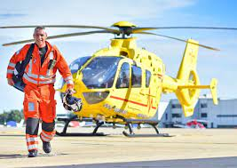
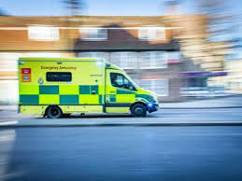
Paramedic
Paramedics look after people who have been involved in accidents and emergencies. They drive ambulances, motorbikes or helicopters to reach the people who need them.

Slide 7
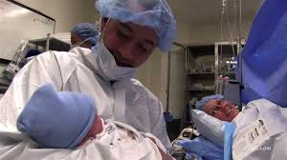
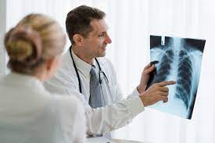
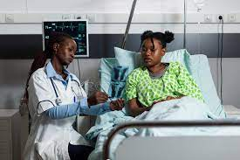
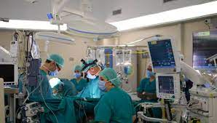
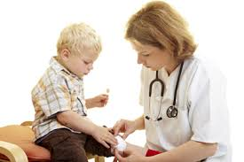
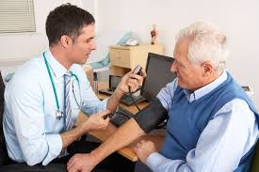
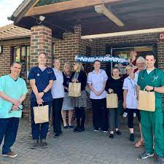
doctor
Doctors work out what is wrong with people and help them to get better. They work in hospitals or at doctors’ surgeries.

Slide 8
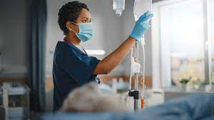
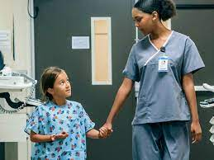
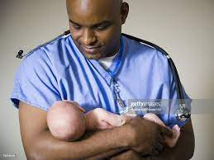
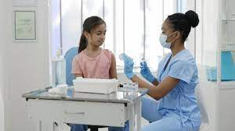
nurse
Nurses care for people who are ill and help people to get better. They canm also help people to stay healthy by giving vaccinations and medicines.

Slide 9
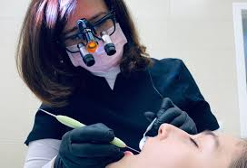
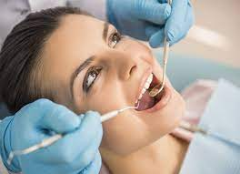
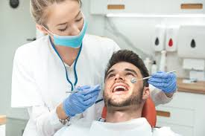
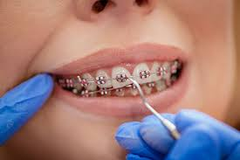
dentist
Dentists help us to look after our teeth and gums. When someone has toothache a dentist can help by giving fillings or taking teeth out. Dentist can fit braces to help to straighten teeth.

Slide 10
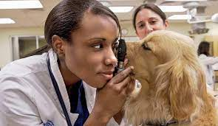
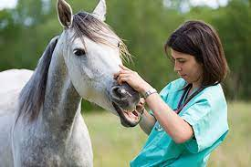
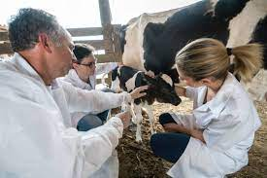
vet
Veterinarians treat the injuries and illnesses of pets and other animals just like a doctor looks after people.

Slide 11
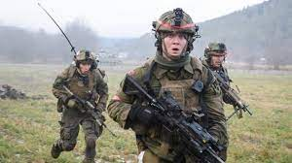
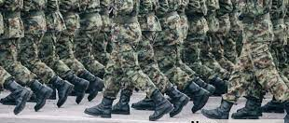
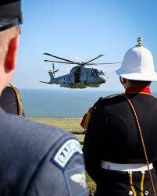
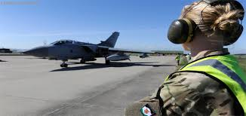
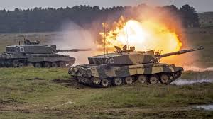
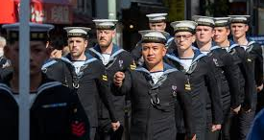
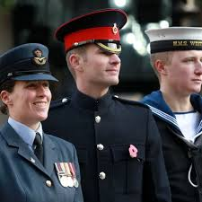
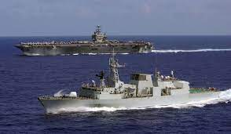
Armed forces
The armed forces includes the British Army, Royal Air Force and Royal Navy. Together, they're responsible for the safety and security of the UK. They're involved in fighting, peacekeeping and helping people in trouble in this country and around the world.

Slide 12
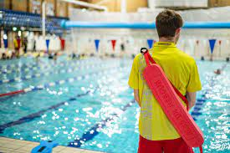
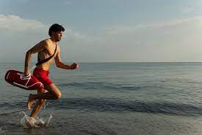
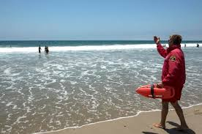
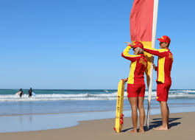
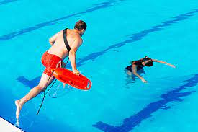
Life guard
Lifeguards prevent accidents by looking after swimming areas, helping swimmers to stay safe and carrying out rescues in emergencies.

Slide 13
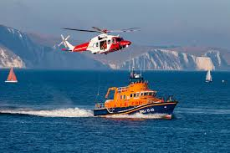
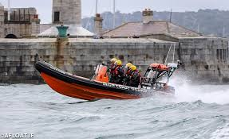
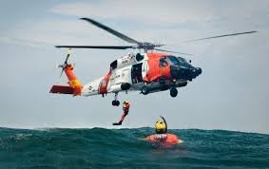
Coast guard
Coastguards help prevent the loss of life along the coast and at sea by co-ordinating and supporting search and rescue operations.

Slide 14






Fire fighter
Firefighters are called to control and put out fires. They work as a team to keep fires from spreading. They may also need to rescue people who are trapped inside burning buildings. Firefighters also help at road accidents and other emergencies like floods or getting trapped .

Slide 15






Police officer
The police stop people from breaking the law, help with emergencies, solve crimes and protect people and their things.

Slide 16




Refuse Collector
Refuse collectors take people's rubbish away in a special lorry that crushes the waste. This is called a dustbin lorry.

Slide 17



Crossing patrol
A lollipop person uses a crossing patrol sign or lollipop to help children and adults to cross the road safely. They stop the traffic by holding up their lollipop stick.

