Slide 1
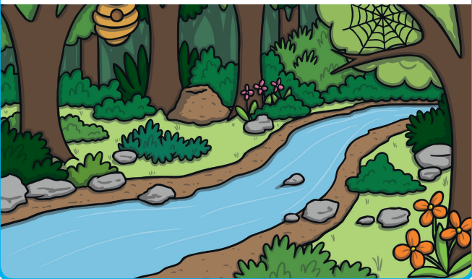
Woodland Animals and The Dark

Slide 2
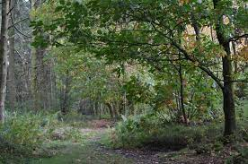
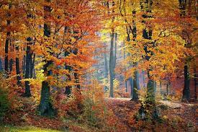
Woodland
A woodland is a place where there are lots of trees growing closely together.

Slide 3
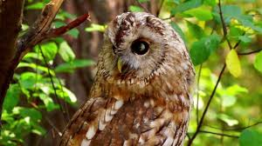
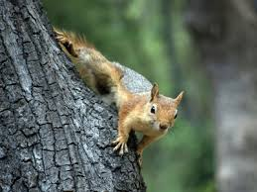
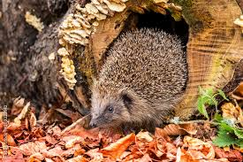
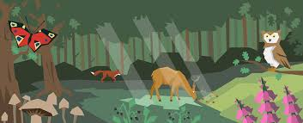
habitat
A habitat is a place where different plants and animals live.

Slide 4
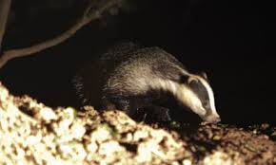
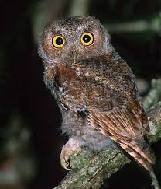
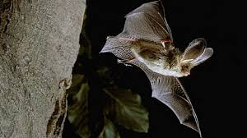
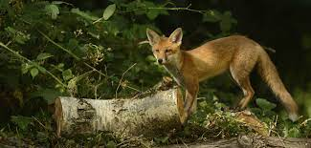
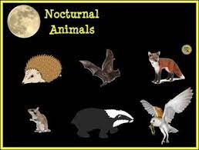
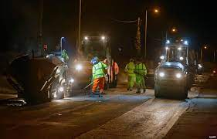
noctural
Nocturnal means things that happen at night. Nocturnal animals are awake during the night and sleep in the day.

Slide 5
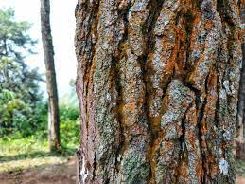
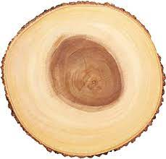
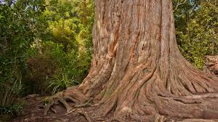
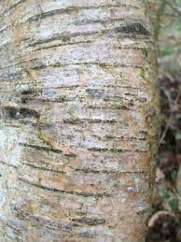
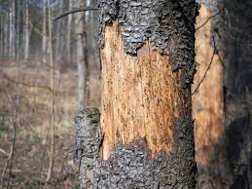
bark
The bark of a tree is its skin. It protects the tree from hot and cold weather and stops it from drying out. It also protects the trunk from insects and other animals.

Slide 6
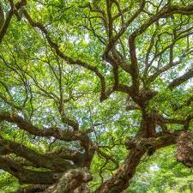
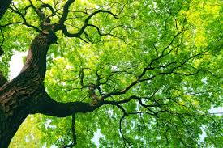
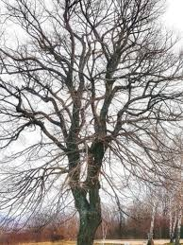
branches
A branch is connected to the trunk of a tree. Large branches are known as boughs and small branches are known as twigs. Leaves and fruit grow on the branches.

Slide 7
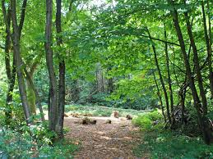
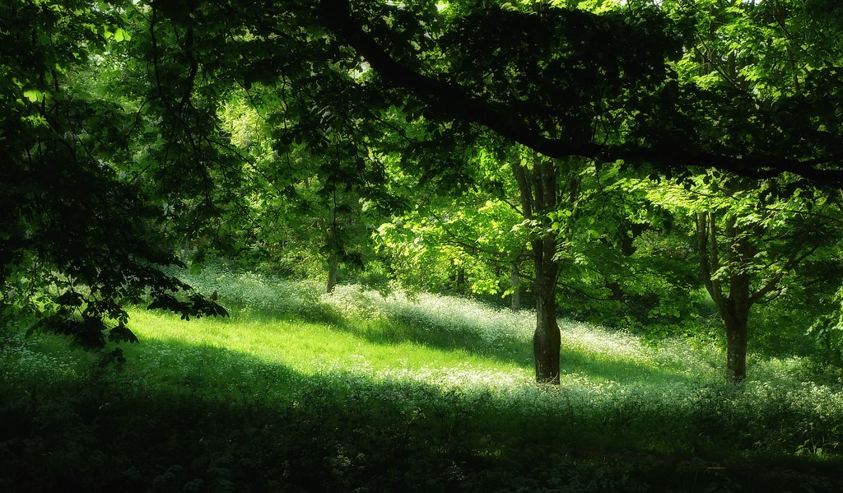
clearing
A clearing is part of the wood where there are only a few or maybe no trees. The sunshine can easily reach the ground in a clearing because there are no trees to block it.

Slide 8
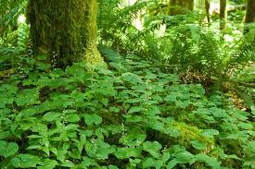
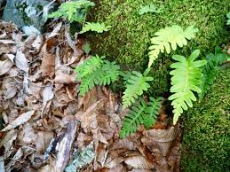
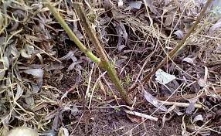
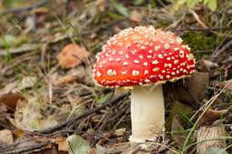
undergrowth
Plants that grow in the shade on the ground under trees in woodland.

Slide 9
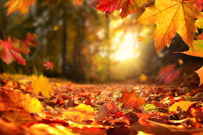
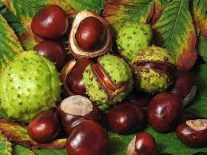
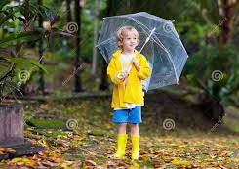
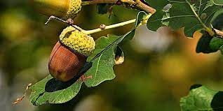
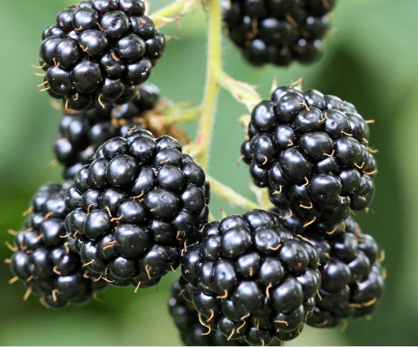
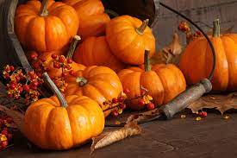
autumn
September, October and November are in the season of autumn. It begins to get dark earlier in the day and the weather is colder and rainy.

Slide 10
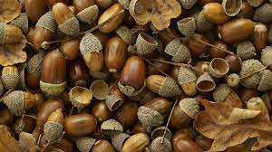
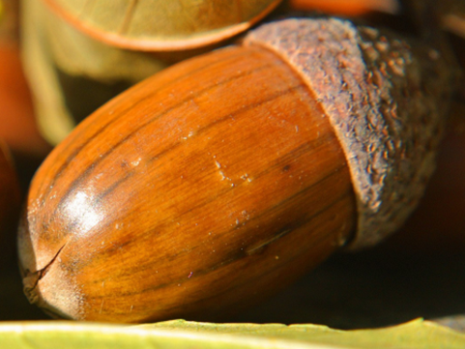
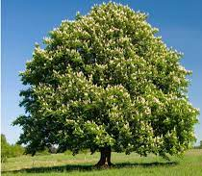
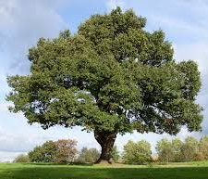
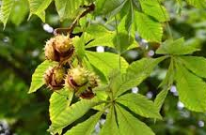
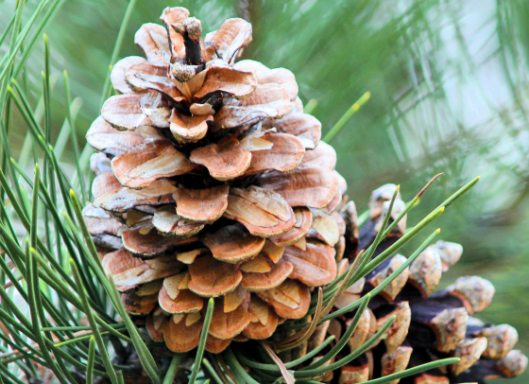
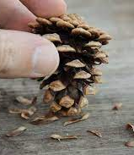
conker
acorn
Acorns grow on oak trees. Acorns have little cups. They are the seeds of the Oak tree. Squirrels love acorns.
pinecone
Conkers grow on Horse Chestnut trees. They have a spiky green case which splits open. The conker is the seed of the tree.
Pinecones grow on fir trees. They have tiny seeds inside them.

Slide 11
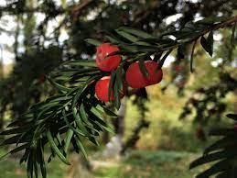
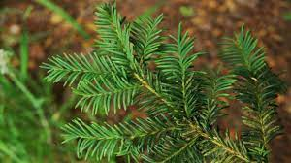
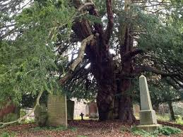
Yew tree

Slide 12
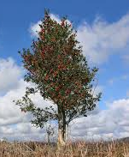
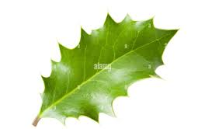
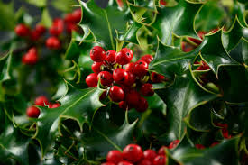
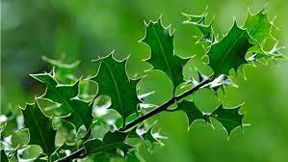
Holly tree

Slide 13
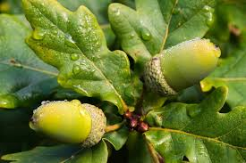
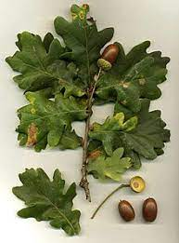
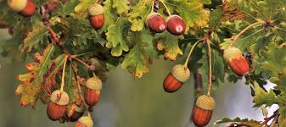

Oak tree

Slide 14





Horse chestnut trees

Slide 15




Evergreen trees
Evergreen trees do not lose their leaves in autumn.

Slide 16



burrow
Rabbits live in underground tunnels and holes called burrows.

Slide 17



Foxes live in underground holes called dens.
Some people call them lairs!
den
lair

Slide 18



set
Badgers live in underground tunnels and holes called sets.

Slide 19




Squirrels build their homes in trees, like a nest. It is called a drey.
drey

Slide 20







predator
A predator is wild animal which hunts or preys on other animals for food.
prey
Prey is an animal that is hunted by another for food.

Slide 21




hibernation
Some animals hibernate in winter. They go into a deep sleep that helps them to save energy and survive the cold weather without eating much.

