Slide 1
Under the Lord’s wings you shall take refuge; His faithfulness is a buckler and shield. You shall not fear the terror of the night, nor the arrow that flies by day. (Psalm 91:4-5)
Thought of the week:

Slide 2
Today many people in England are celebrating St. George’s Day.
But who was St. George?

Slide 3
Dear Lord,
Please help us to learn from the example of St George by helping others to make the world a better place.
Help us to realize that helping others is its own reward.
Help us to find the courage within ourselves to do the right thing, even if it means going against the crowd.
Please give us the strength always to try to follow the truth and to do what is helpful for others.
Amen.

Slide 4
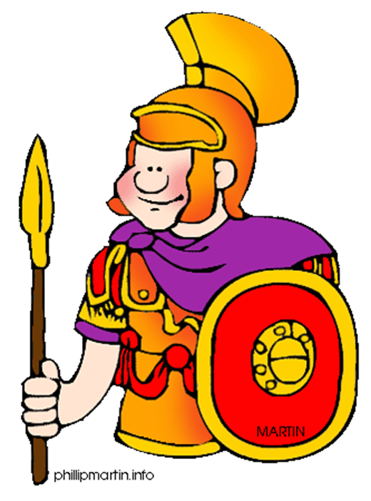
George was an excellent soldier and was chosen to protect the emperor, Emperor Diocletian.

Slide 5
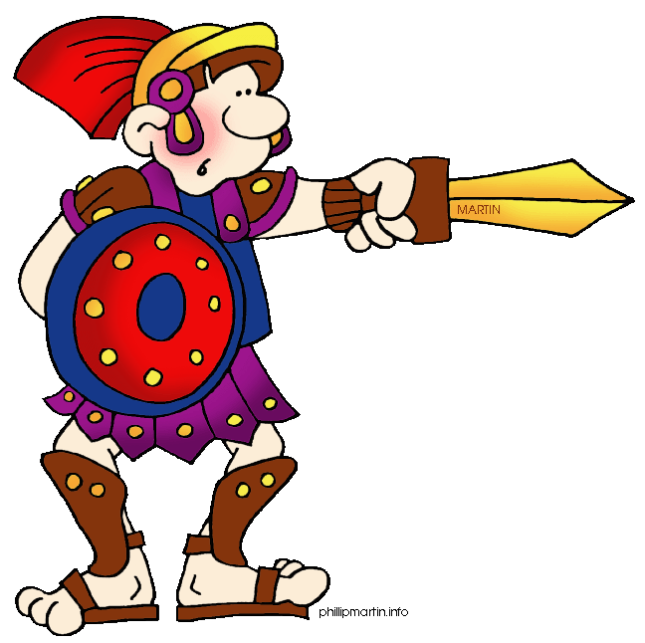
Emperor Diocletian was not a Christian, in fact he hated Christians! He order that any Christians within the Roman army should be killed!

Slide 6
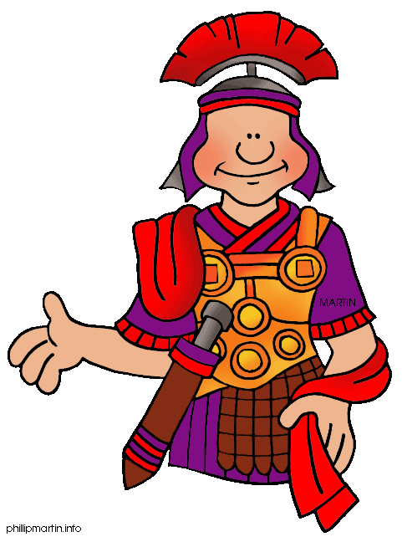
George disagreed with the emperor and told him that he was, himself, a Christian. The emperor didn’t want to lose one of his best soldiers and tried to convince George to stop being a Christian. He even offered him land and money!

Slide 7
Time and time again, George refused the emperor’s offers, saying that his Christian faith was too important to him.
Eventually Diocletian lost patience and had George beheaded on 23rd April 303.

Slide 8
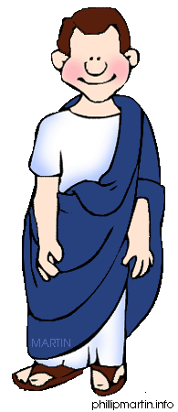
Christians were so proud of George’s bravery that he was made a saint.
They built churches in his honour and George’s story was used to demonstrate the power of faith and to convince others to become Christians.

Slide 9
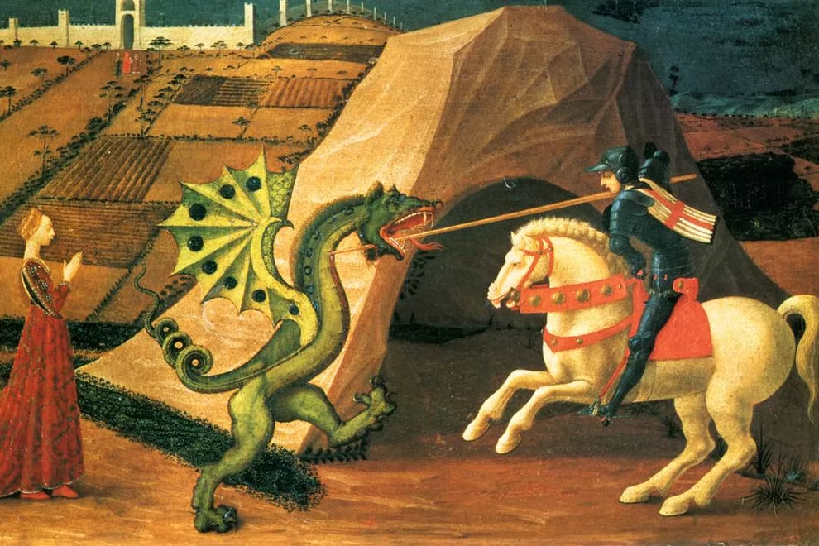

Slide 10
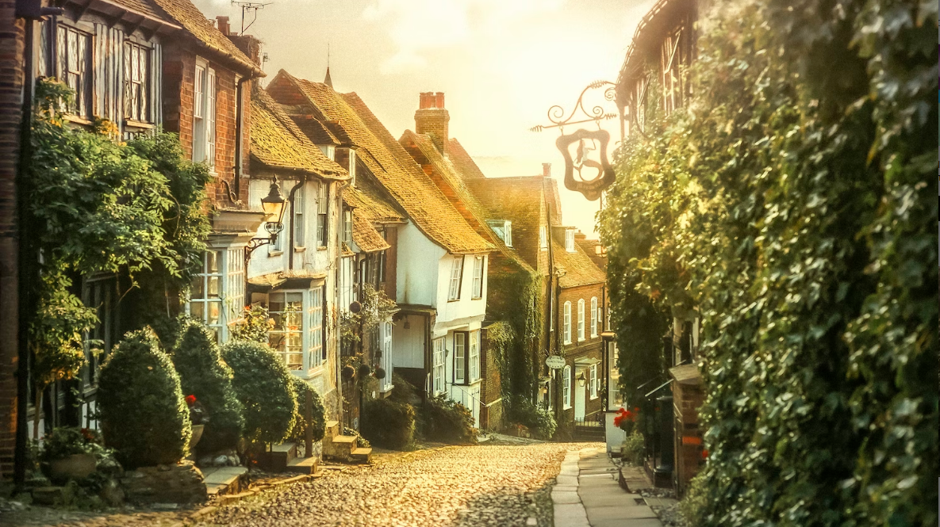

Slide 11
As a class we then thought about times, when we felt brave.

