Slide 1
Y4H Assembly

Slide 2
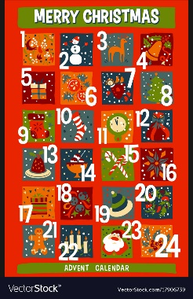
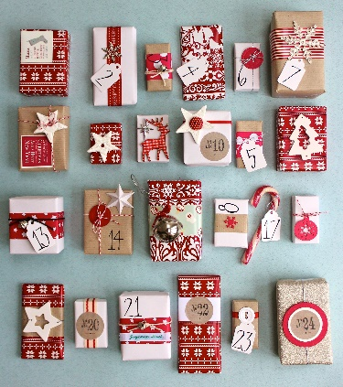
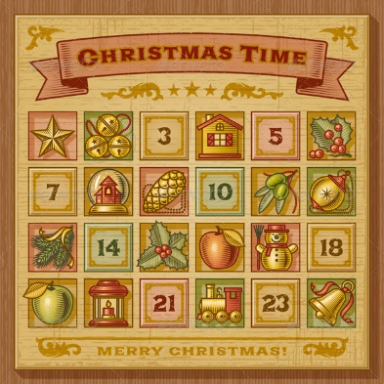
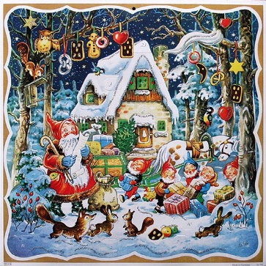

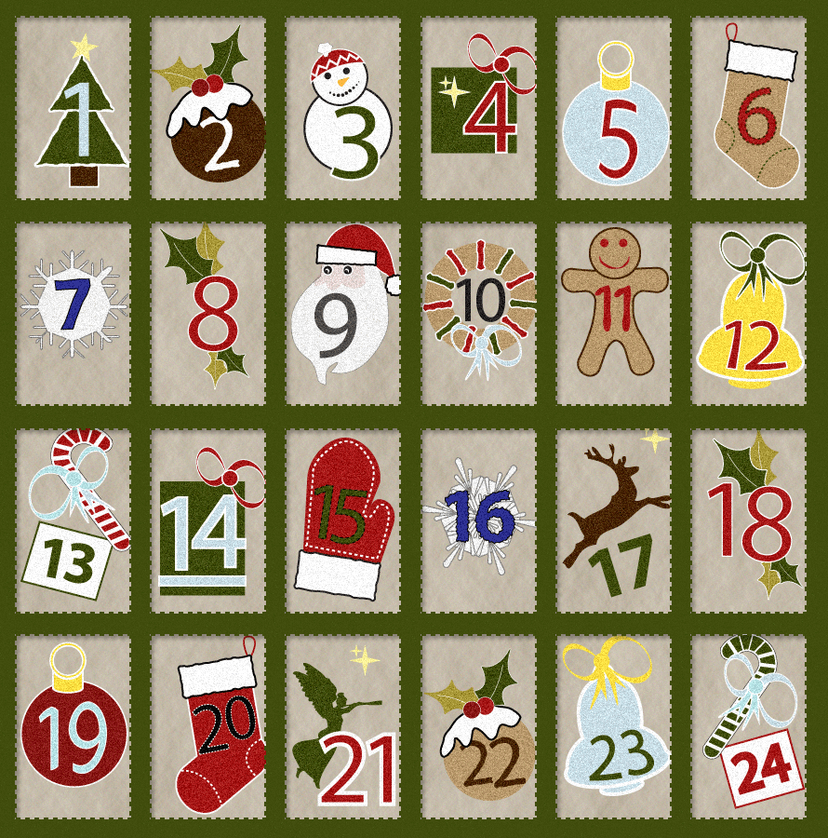

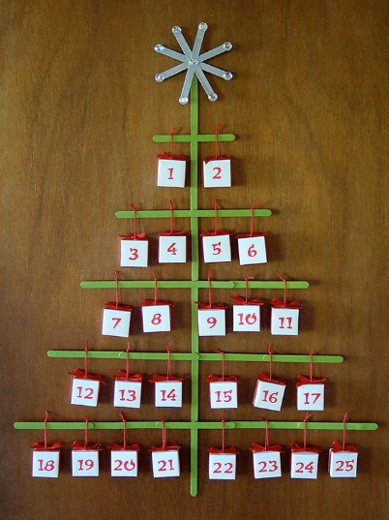

Advent Calendars
What type do you have?

Slide 3


Slide 4
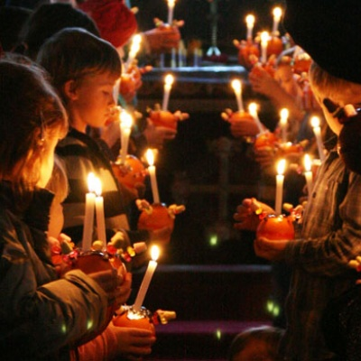
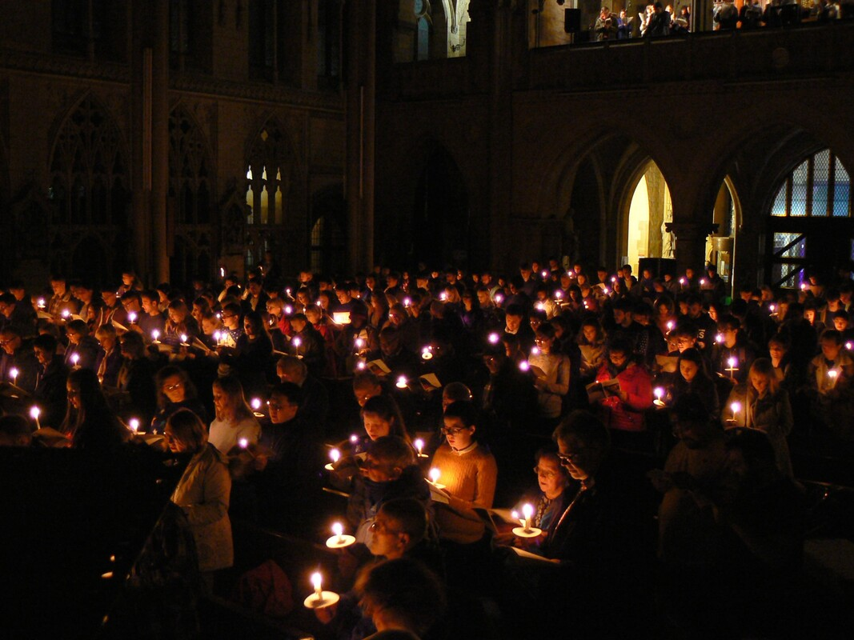
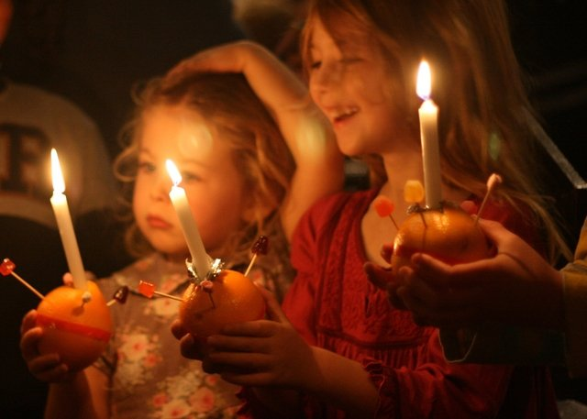

Slide 5
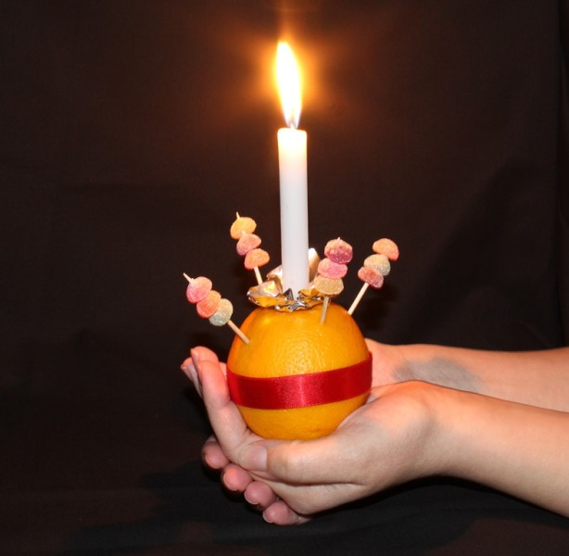

Slide 6


Slide 7

Arrival
D
V
E
N
T

Slide 8

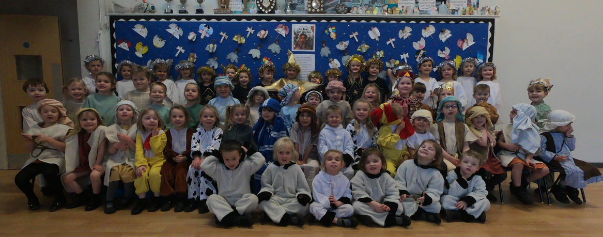
Arrival
December
V
E
N
T

Slide 9

Arrival
December
Violet
E
N
T

Slide 10

Arrival
December
Violet
Emmanuel
N
T

Slide 11

Arrival
December
Violet
Emmanuel
Near
T

Slide 12

Arrival
December
Violet
Emmanuel
Near
Time

Slide 13


Slide 14


