Slide 1
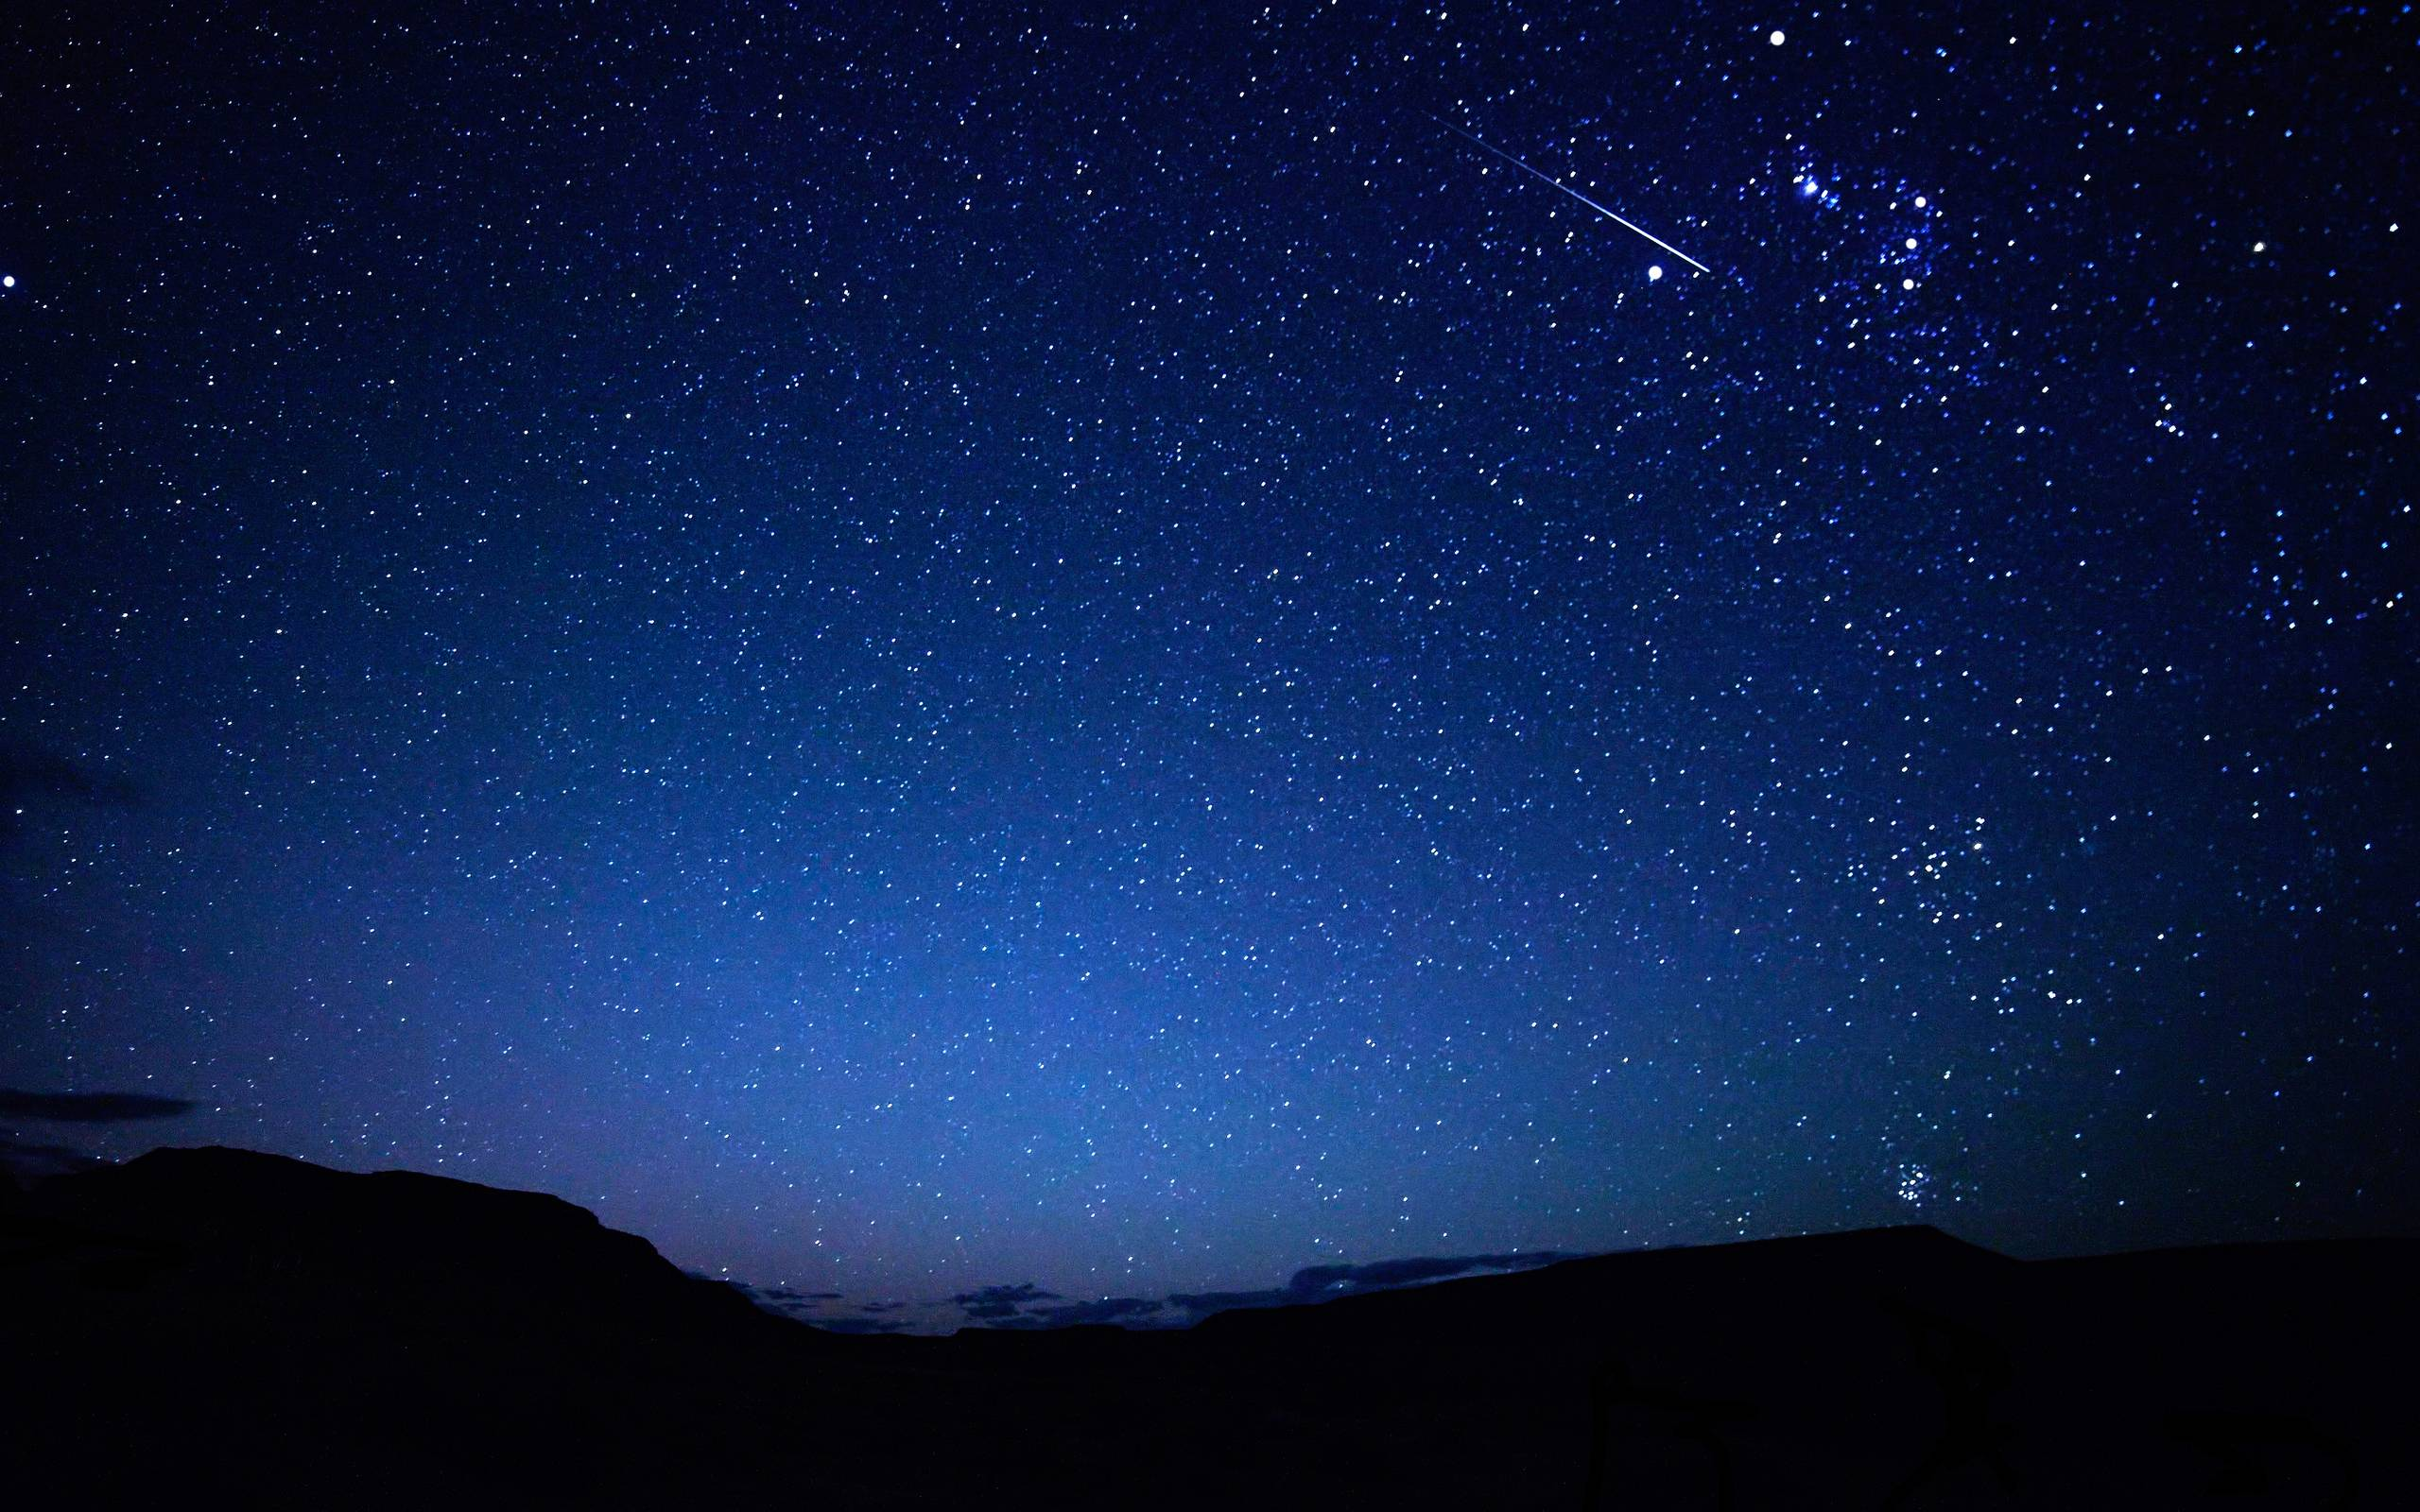


Slide 2


Slide 3
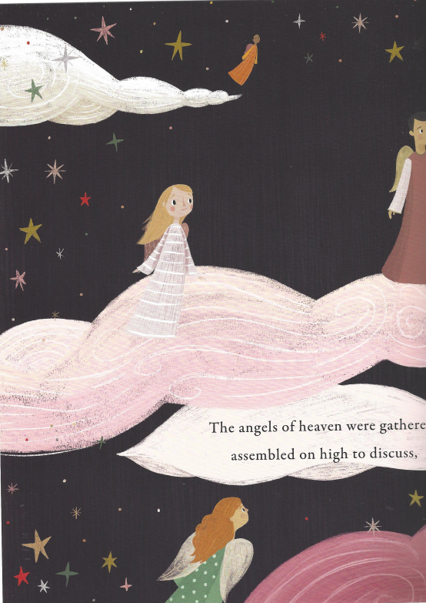

Slide 4
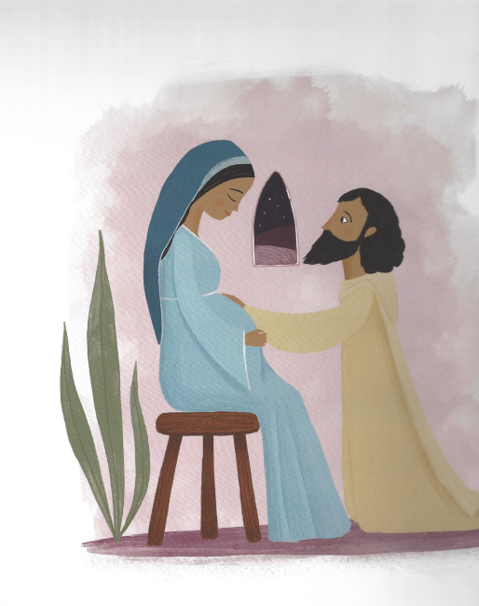

Slide 5
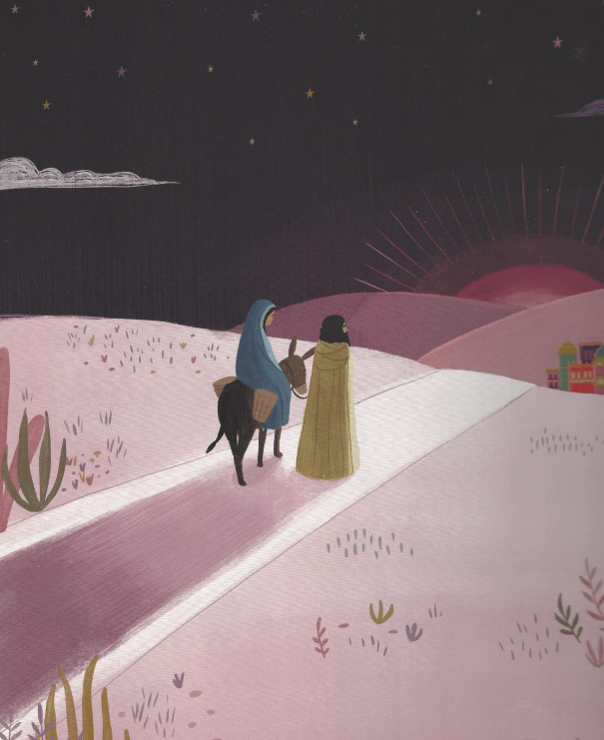

Slide 6
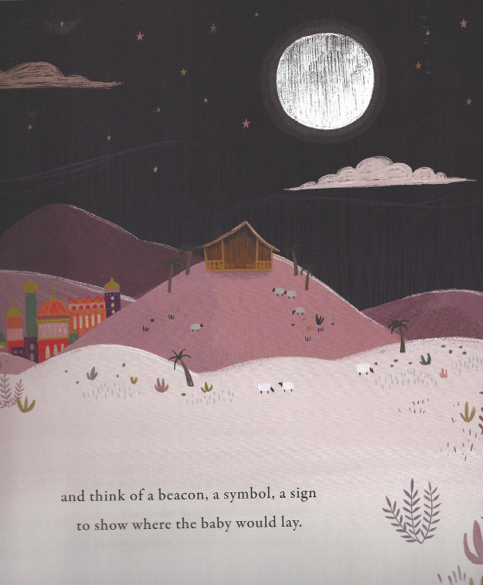

Slide 7
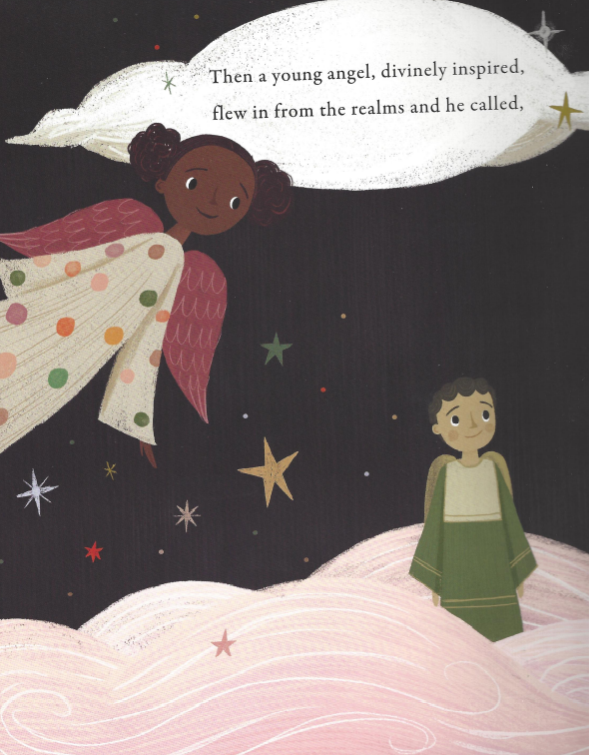

Slide 8
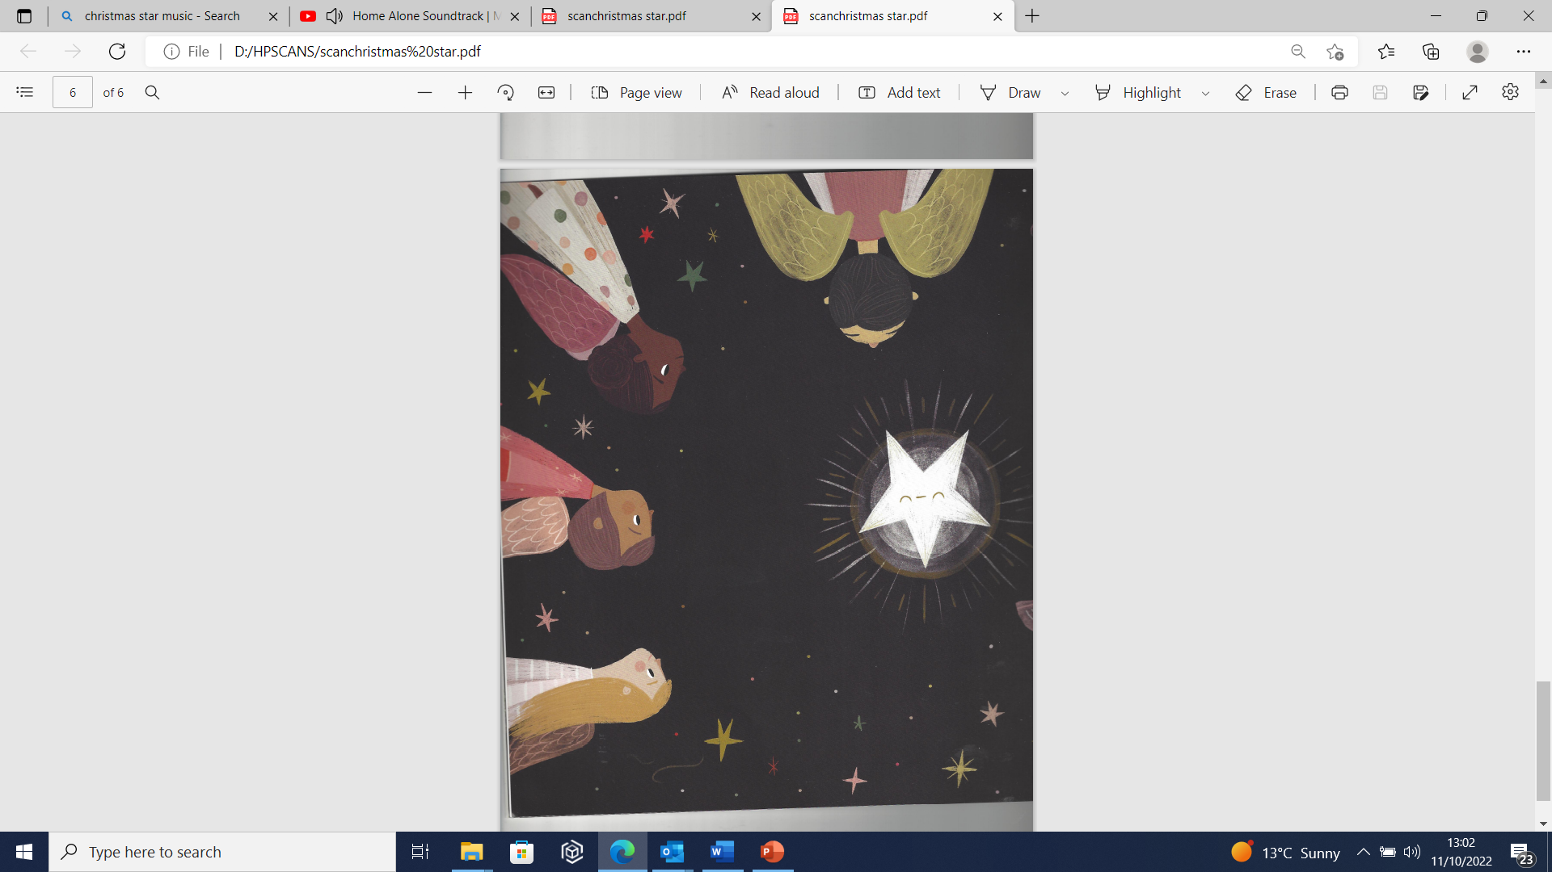

Slide 9
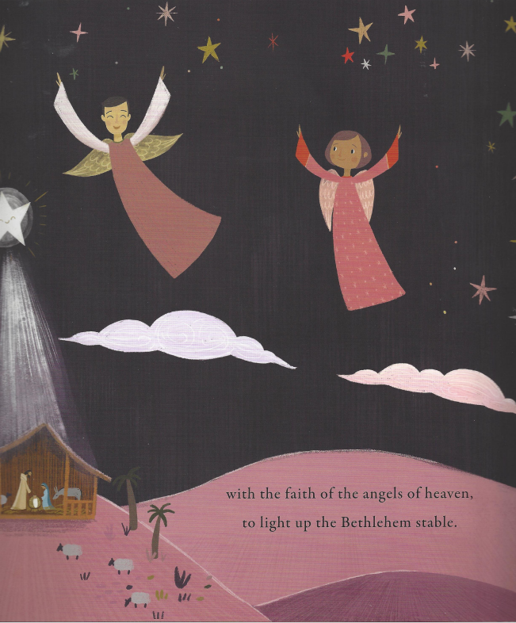

Slide 10
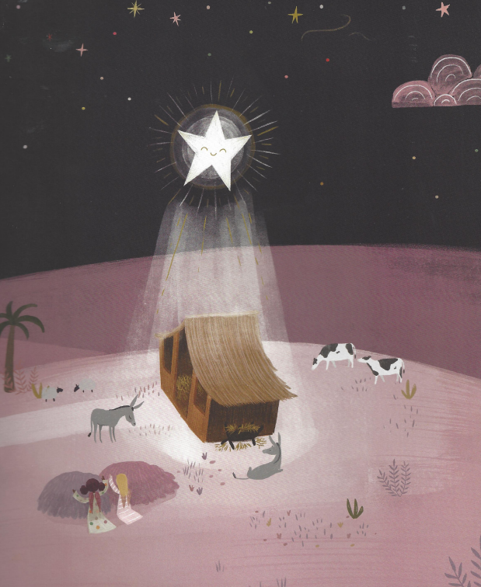

Slide 11
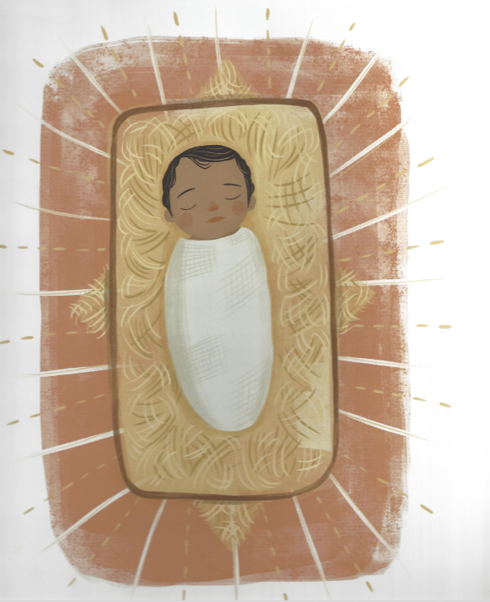

Slide 12
‘Don’t judge me by outward appearance, please give me your faith and your trust, then my soul will glow with assurance and I’ll do whatever I must.’

Slide 13

People look at the outside, but God looks at the heart..
People look at the outside, but God looks at the heart.
I Samuel 16:7

Slide 14
Dear God,
Thank you that we can all be part of your story,
No matter how big or small we are,
No matter what we look like,
No matter who we are.
Please help us all to shine for you,
Today, this week and in the future.
Amen.

Slide 15
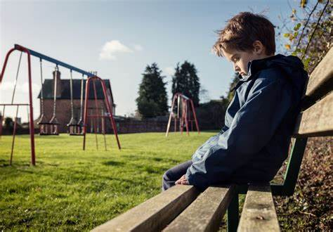

Slide 16


