Slide 1
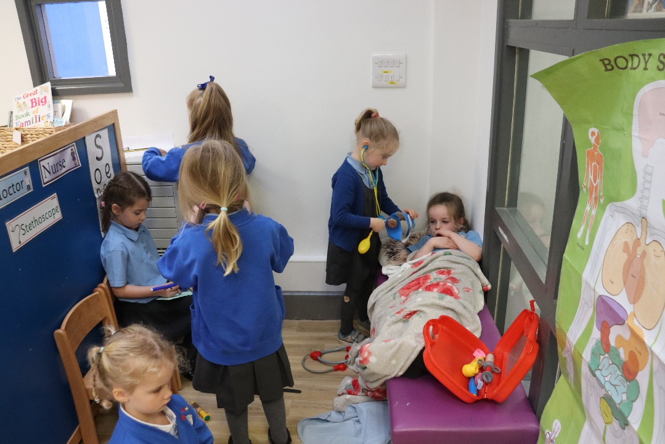
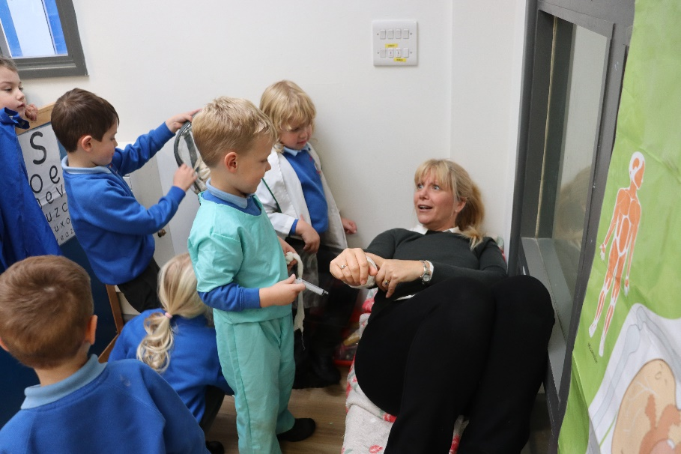
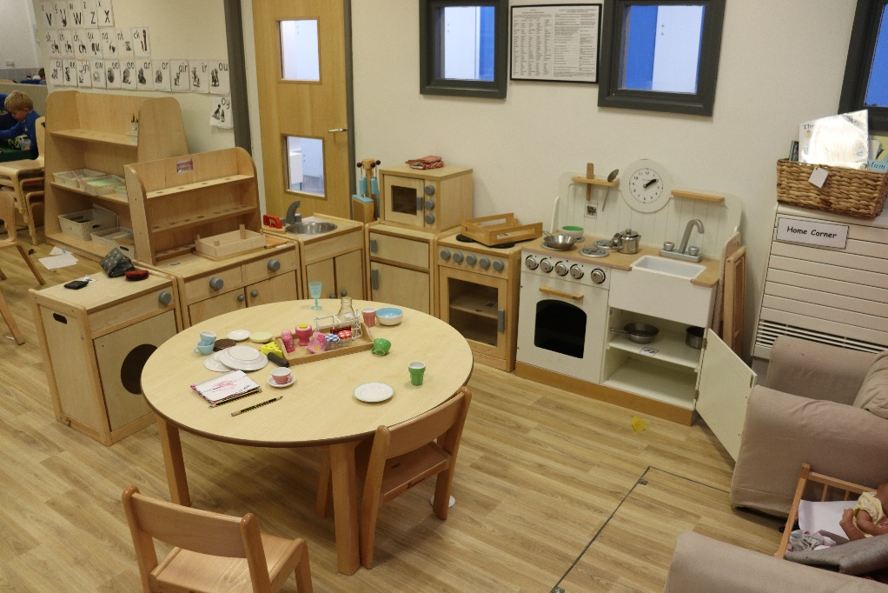
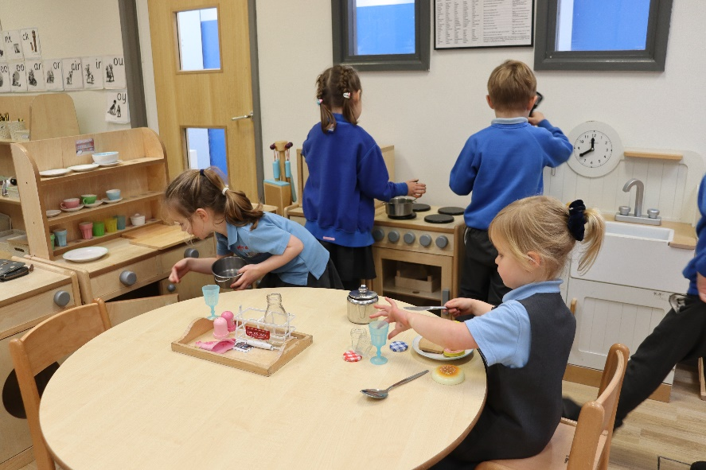
Domestic role play & topic based role play areas
Children go from their home to the shops or the doctor’s surgery. These areas are often busy and noisy with plenty of opportunity for social interactions between different friendship groups who all share a common concept of “home” & “family life” role play.

Slide 2
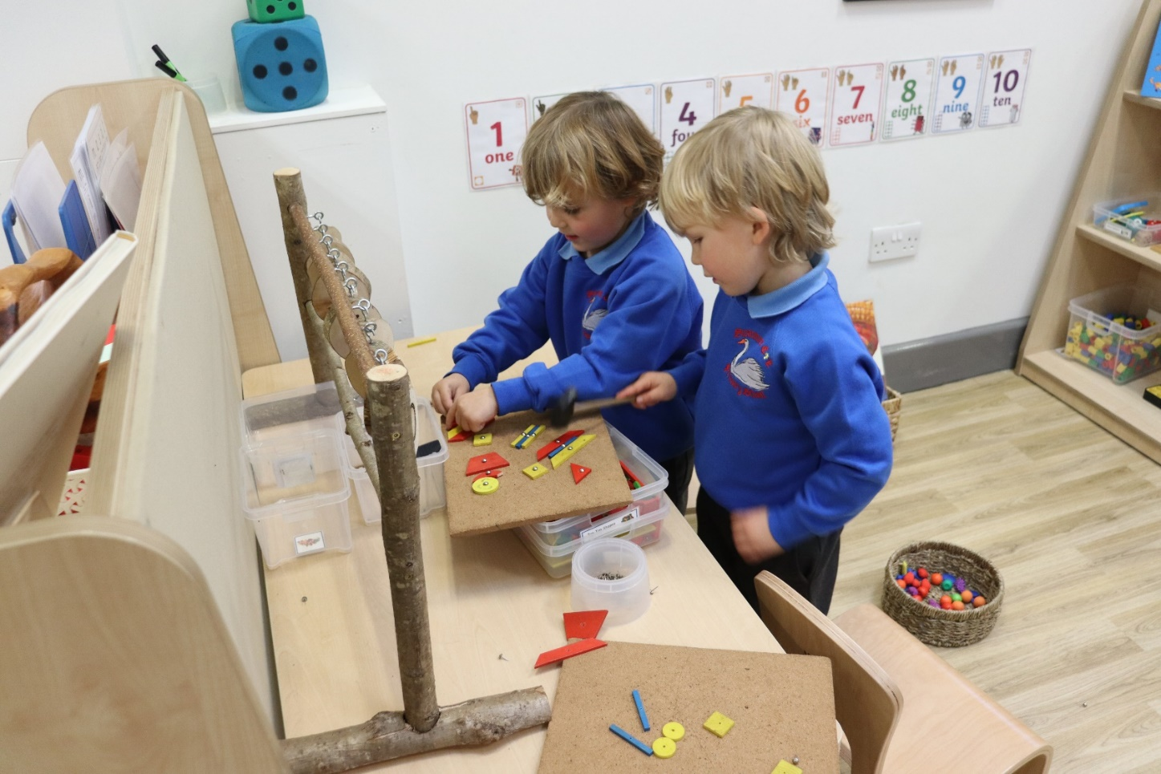
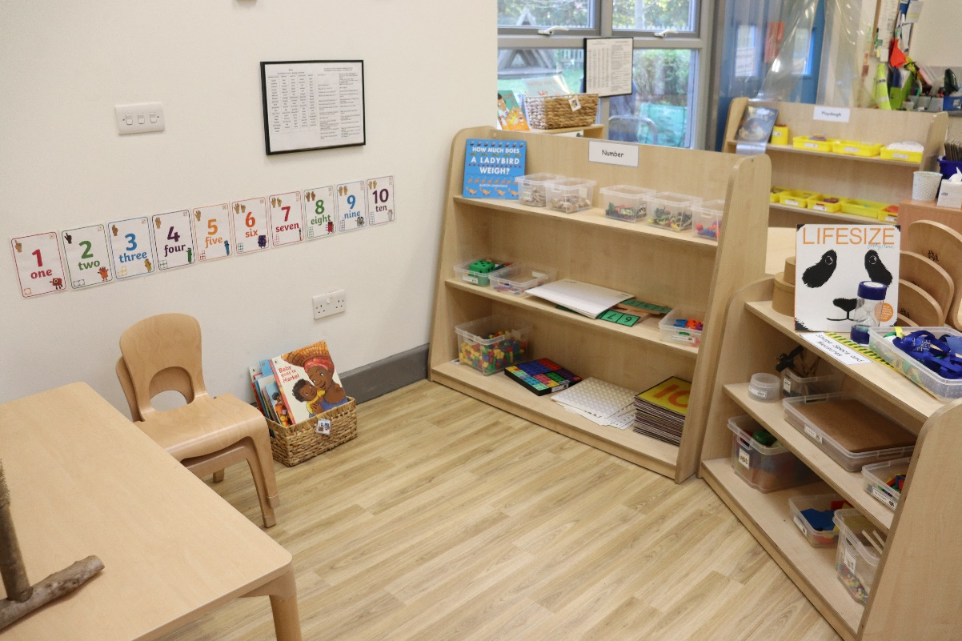
Maths Area
The maths area has both table tops and floor space to help the children with their understanding of pattern making, sequencing and, through a range of equipment to develop their understanding and fluency with number, shape, space and measures.

Slide 3
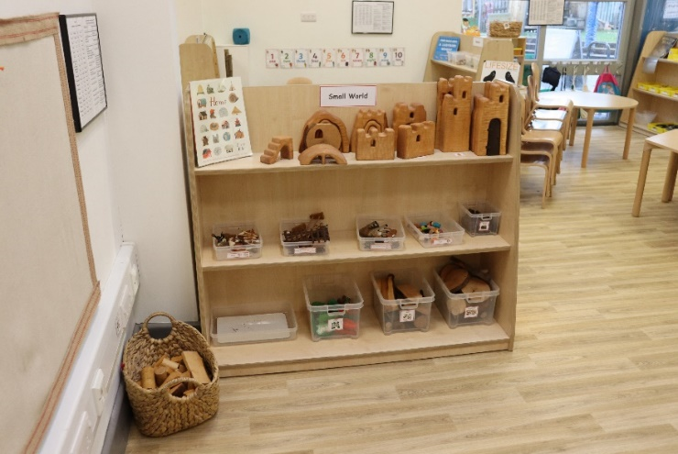
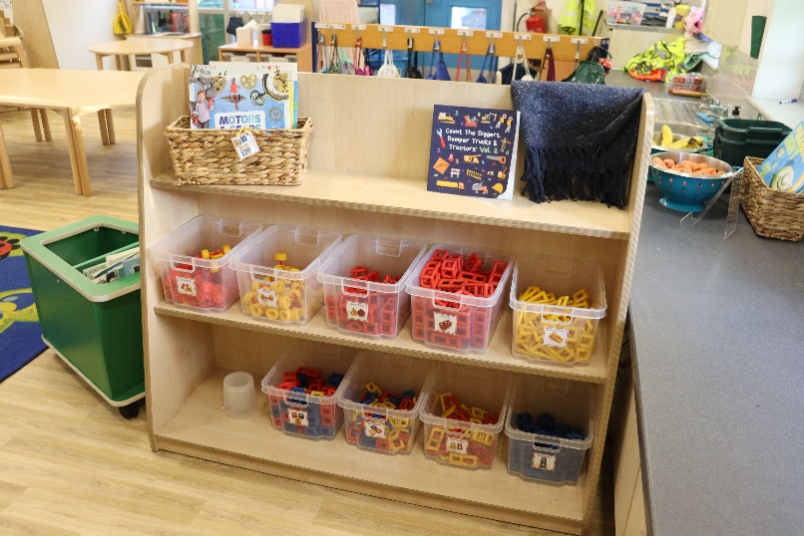
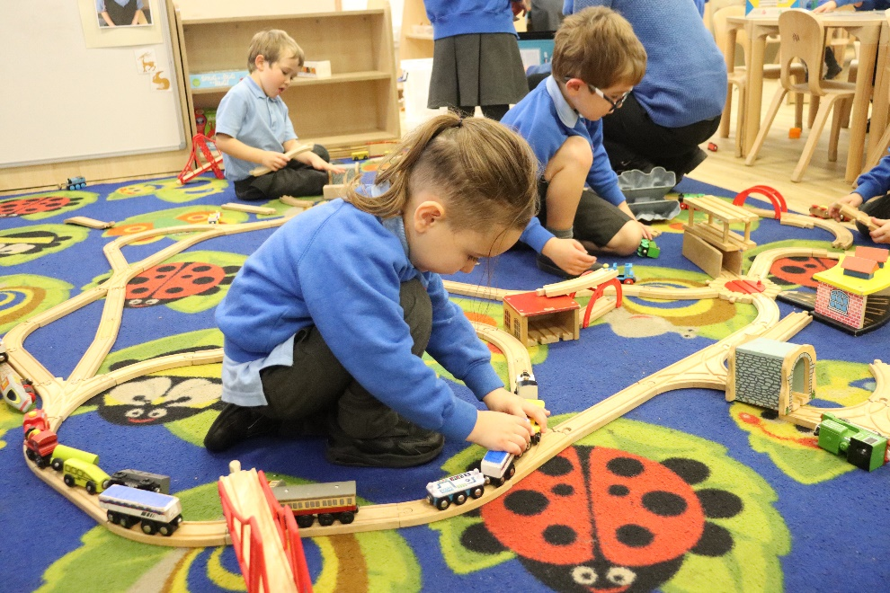
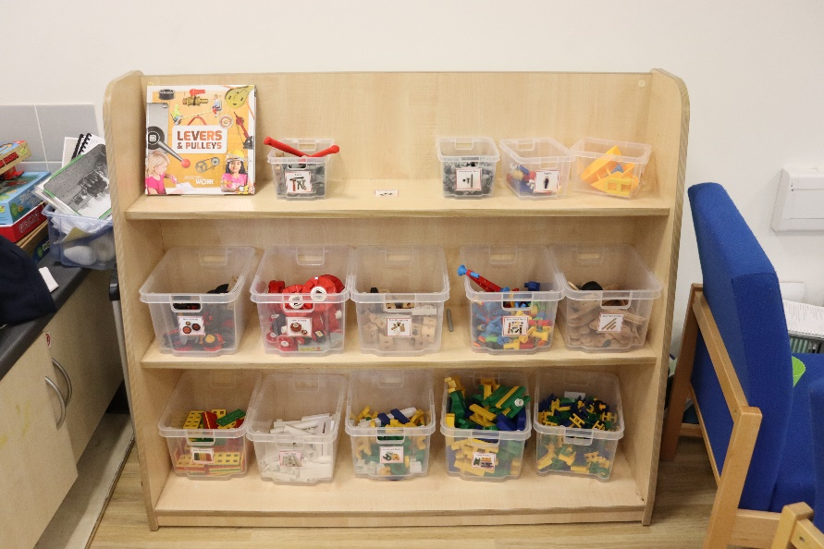
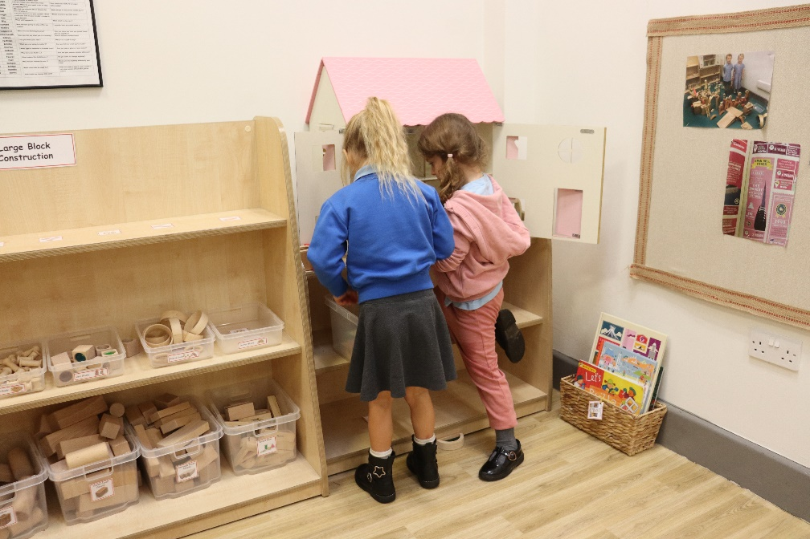
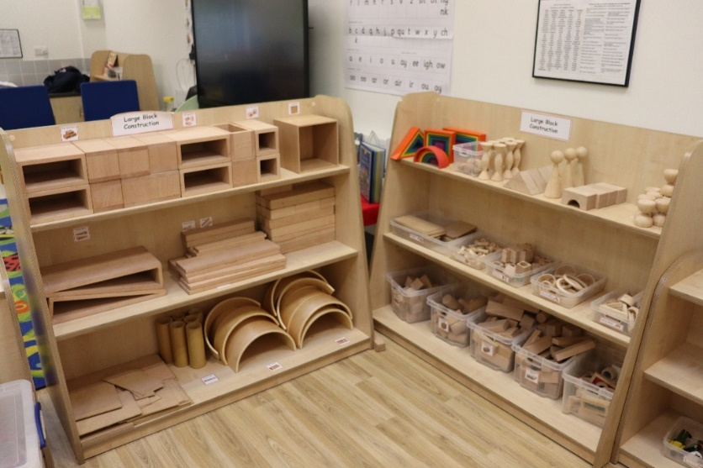
Large Block Construction and Small World
Large block Construction and Small World are two areas combined so the children can build miniature environments and act out scenarios using small world figures. Plenty of floor space rather than tables enable the play to grow and evolve. This is a highly creative (sometimes noisy) area which also encourages sharing, problem solving, critical thinking, resilience and is also an area rich in communication opportunities.

Slide 4
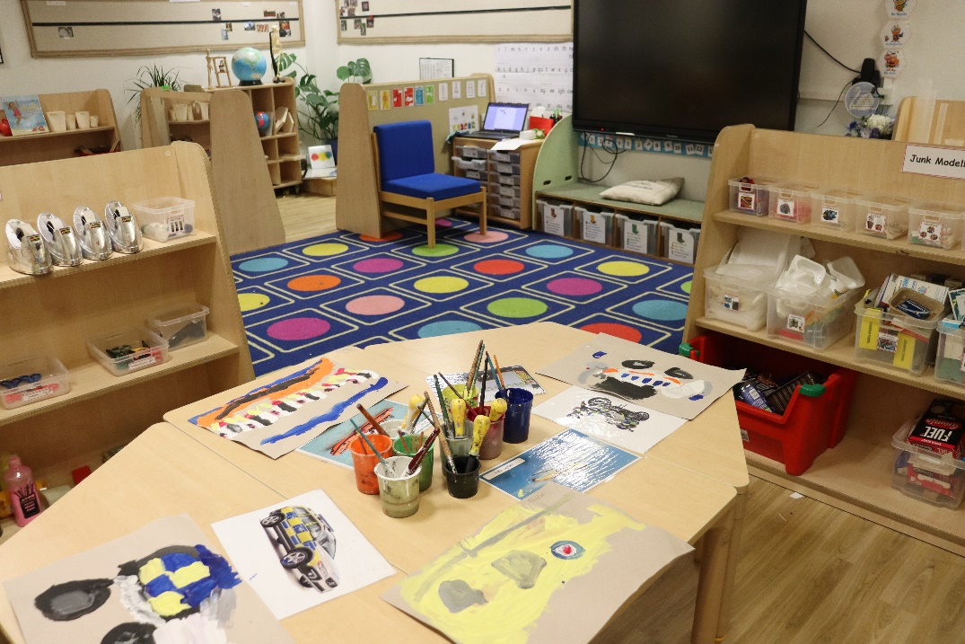
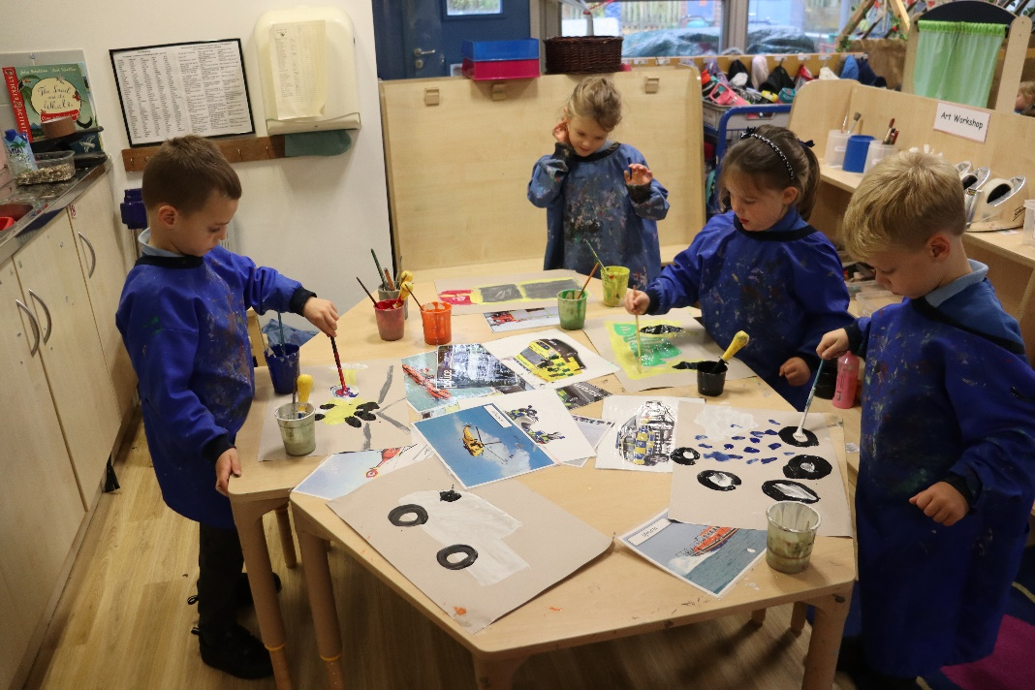
The Art area is positioned near to a sink and the Junk modelling workshop. Table tops are important for sociable and collaborative work to take place. An easel is also set up to ensure that there is always a space reserved for painting and to help develop gross motor skills and hand eye co-ordination. Tools and equipment are readily available to promote independence alongside creativity and exploration. Recycled and decorative materials are provided alongside a range of opportunities to cut and fix.
The Art Area

Slide 5
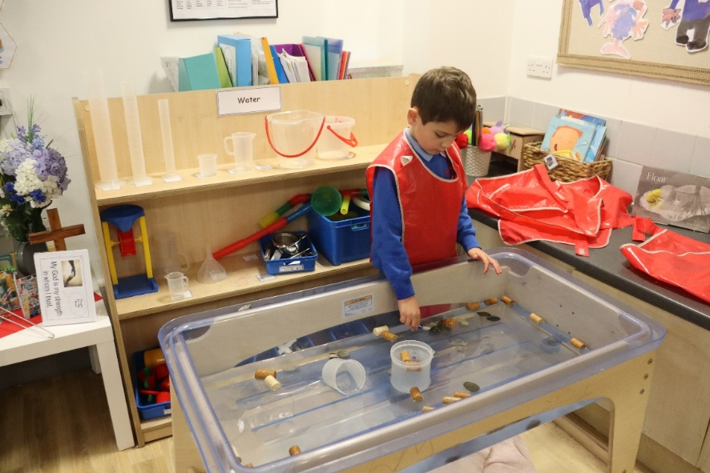
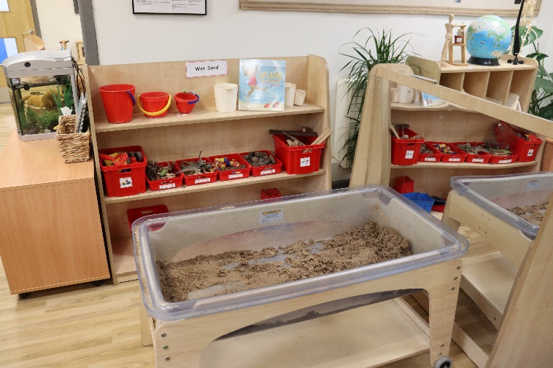
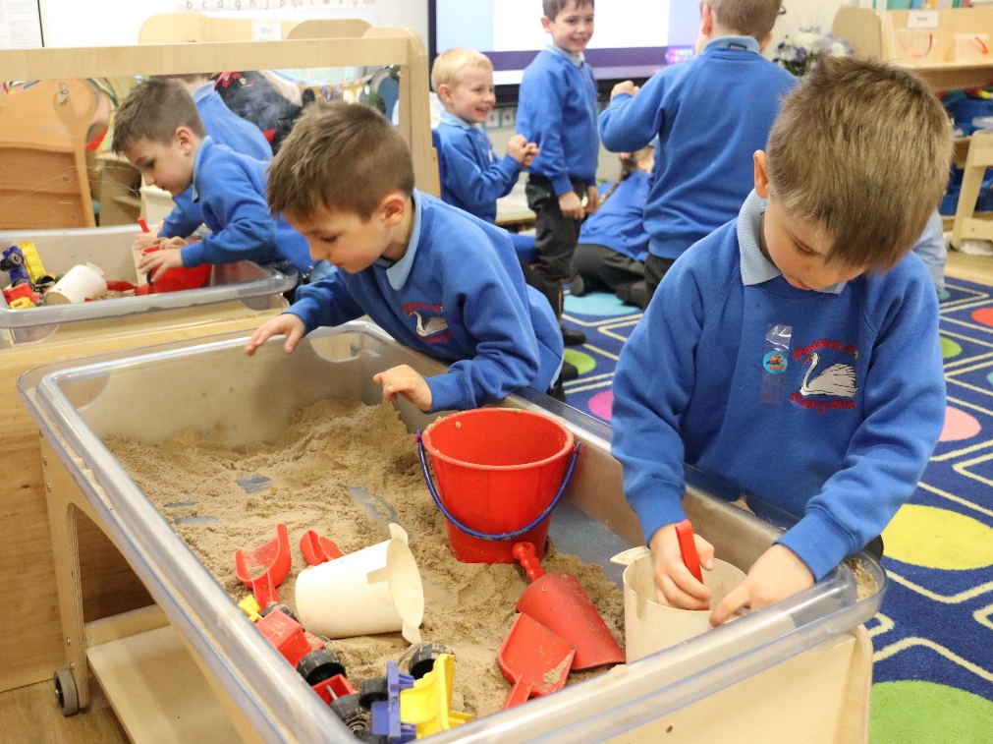
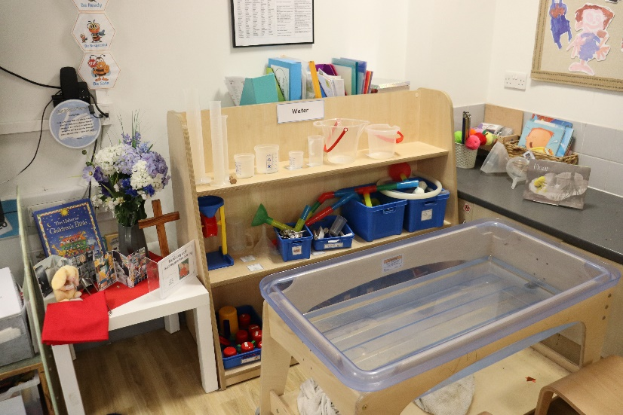
The sensory nature of Sand and Water means that this area is often messy and lively but full of rich learning and sociable opportunities. These two areas are situated next to each other and near to a sink. Observing how water reacts with other objects, exploring cause & effect, movement, speed, flow and capacity are all by-products of children following their natural desire to experiment with water.
The flexibility of wet sand enables the children to explore how they can shape, move and control materials. Children can also use small world resources to develop their imagination. Both sand and water require the children to develop their independence and negotiation skills as only 4 children are allowed in each area. They also need to take responsibility for keeping the area clean and tidy.
Sand and Water Trays

Slide 6
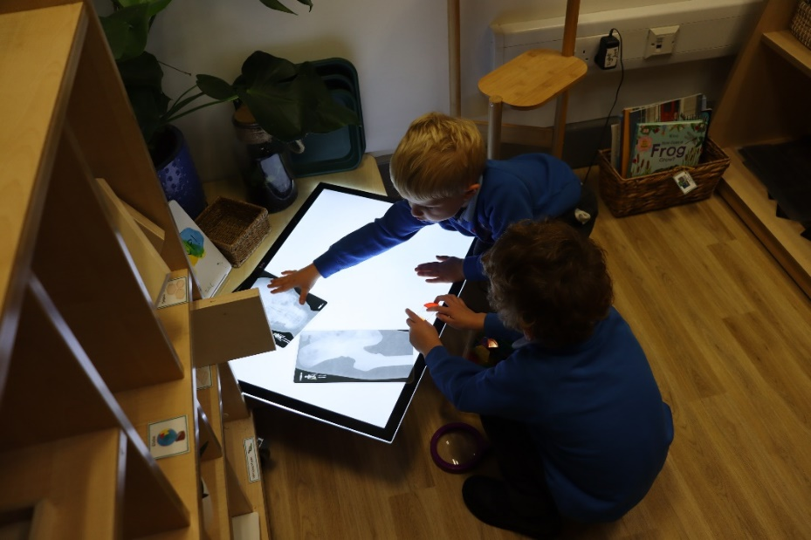
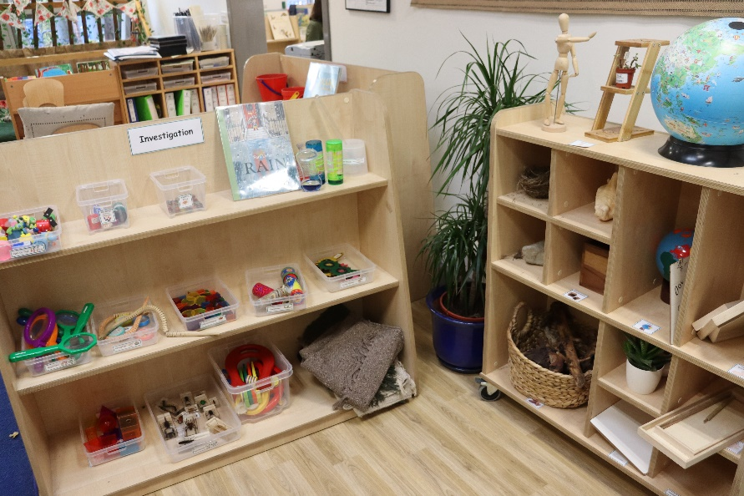
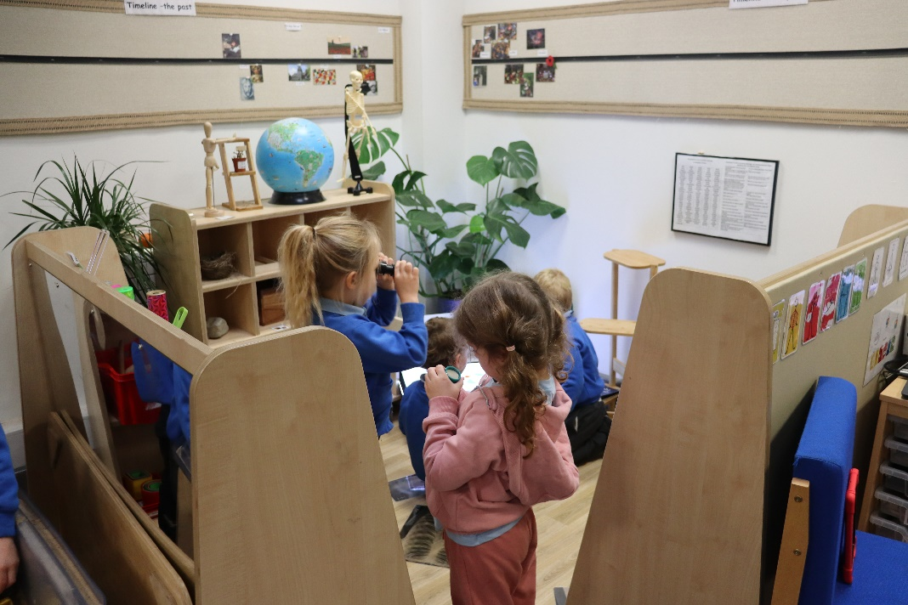
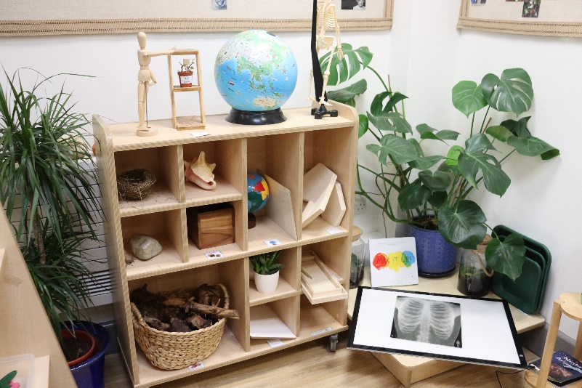
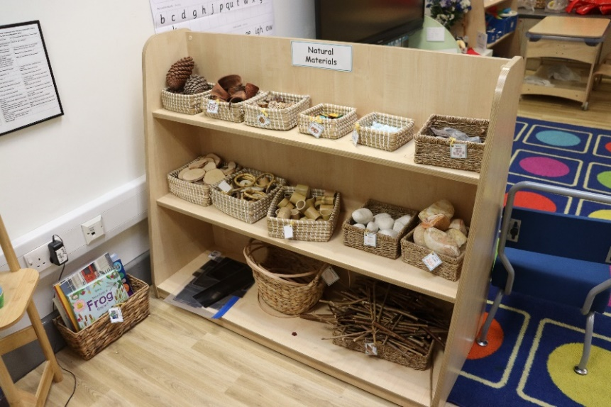
The investigation area/station offers the chance to explore, experiment and observe & is coupled with the opportunity to do observational drawing. Nature is at the heart of this area where children learn to appreciate the ever changing seasons and explore the fascination of the natural world. Alongside resources to encourage investigation there are also a range of natural resources to aid the children as they explore pattern, shape, colour, texture and size.
The Investigation Area

Slide 7
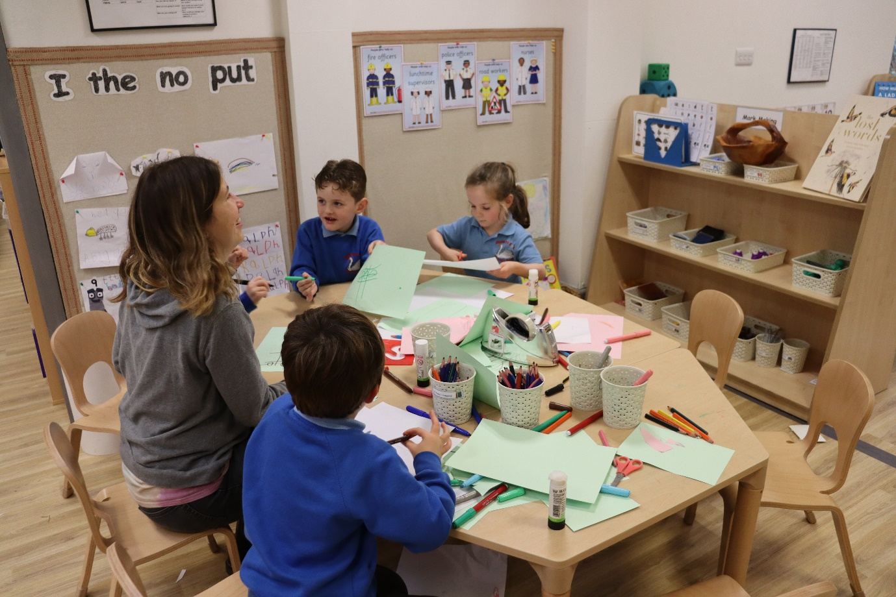
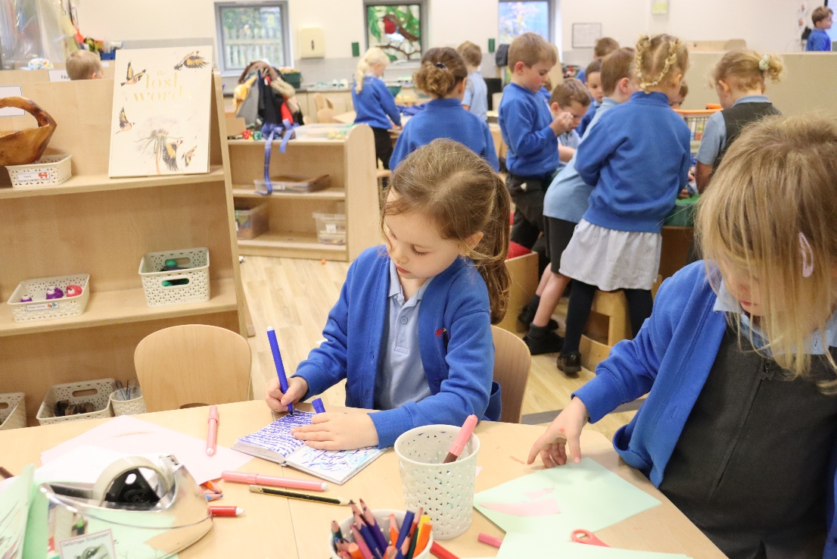
The Mark Making Area
The Mark making area has several tables to promote the importance of good posture for pencil control. The area is positioned in the heart of the unit between both classrooms so that it is easily accessible for writing inspirations that have originated in the different areas. There is range of tools and resources to entice the children to pick up a pencil alongside equipment that provide a scaffold to practice and develop their writing skills.

Slide 8
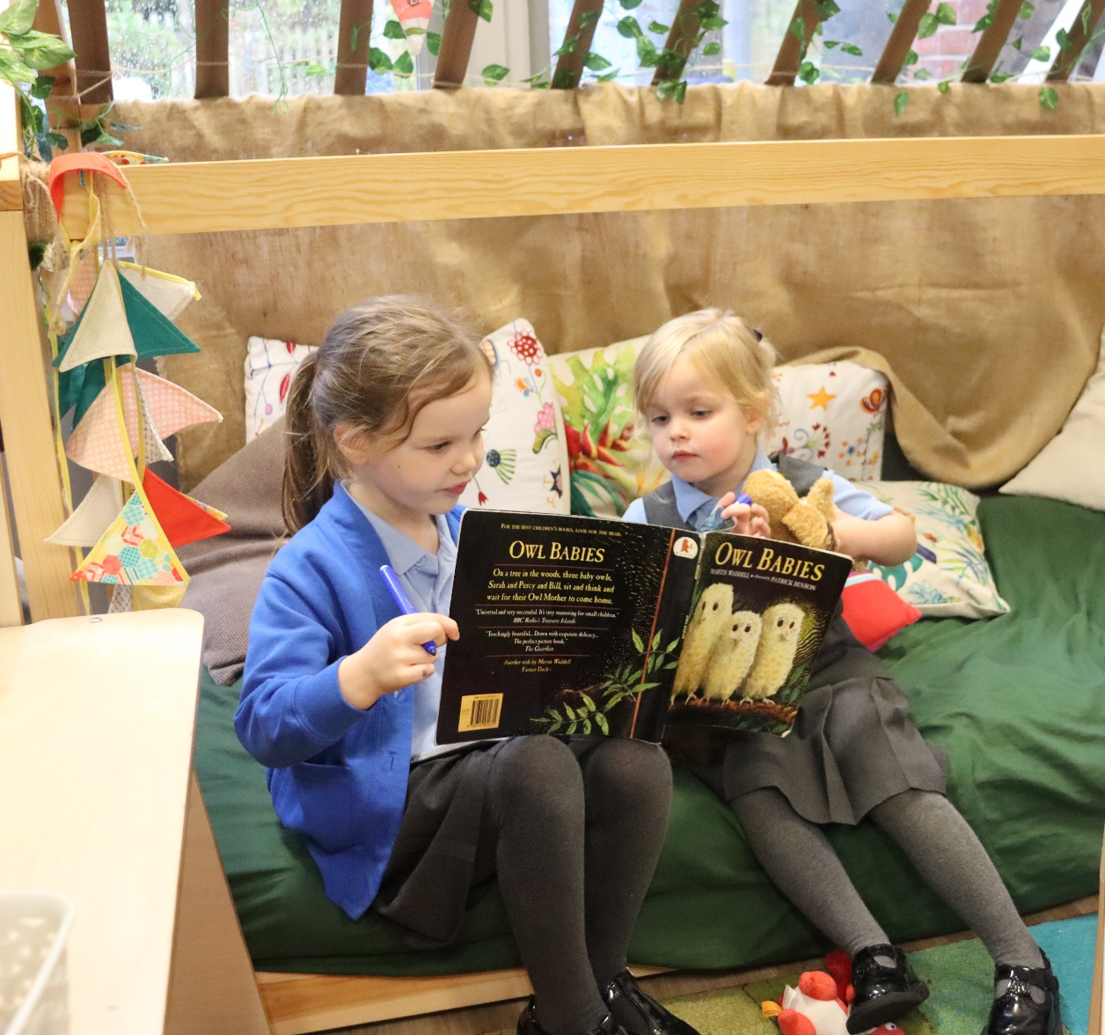
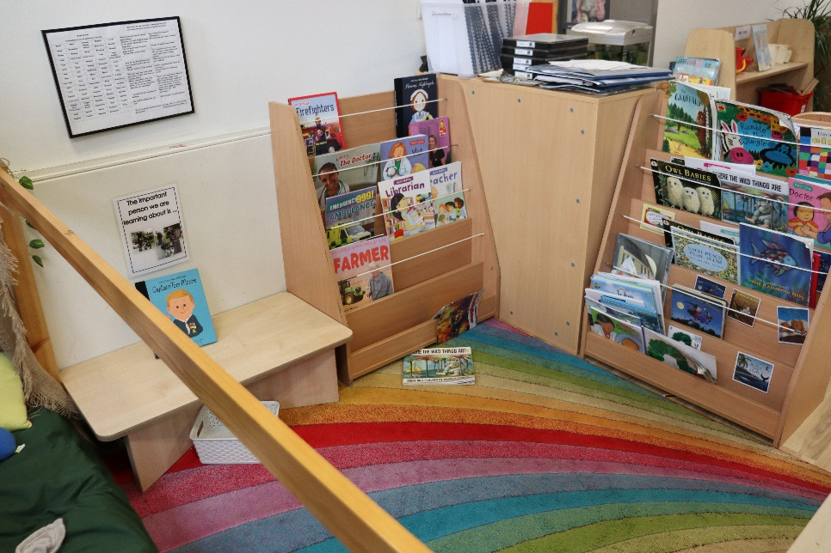
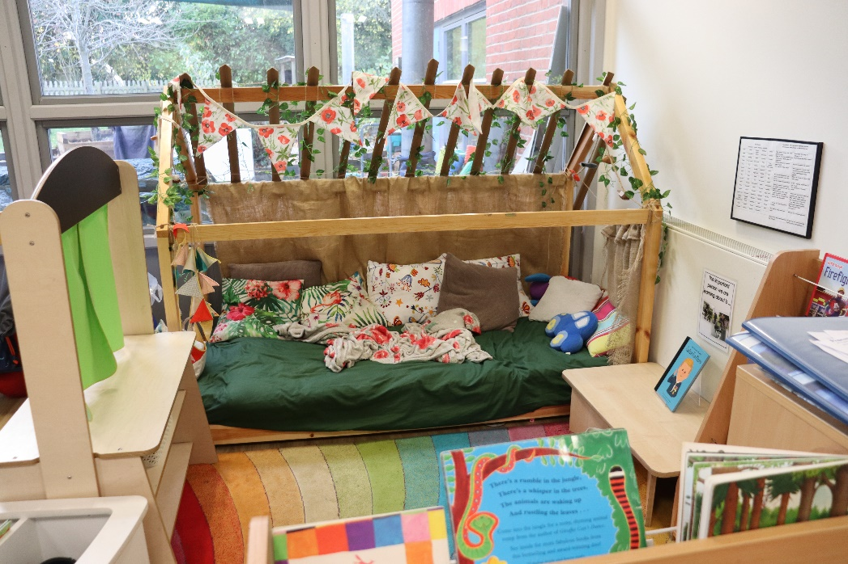
The Book corner
The Book corner is positioned in a quieter area of the unit and the cosy space with soft seating on the low level bed offers a homelike comforting quality designed to be a gentle sanctuary to engage with books and stories.

Slide 9
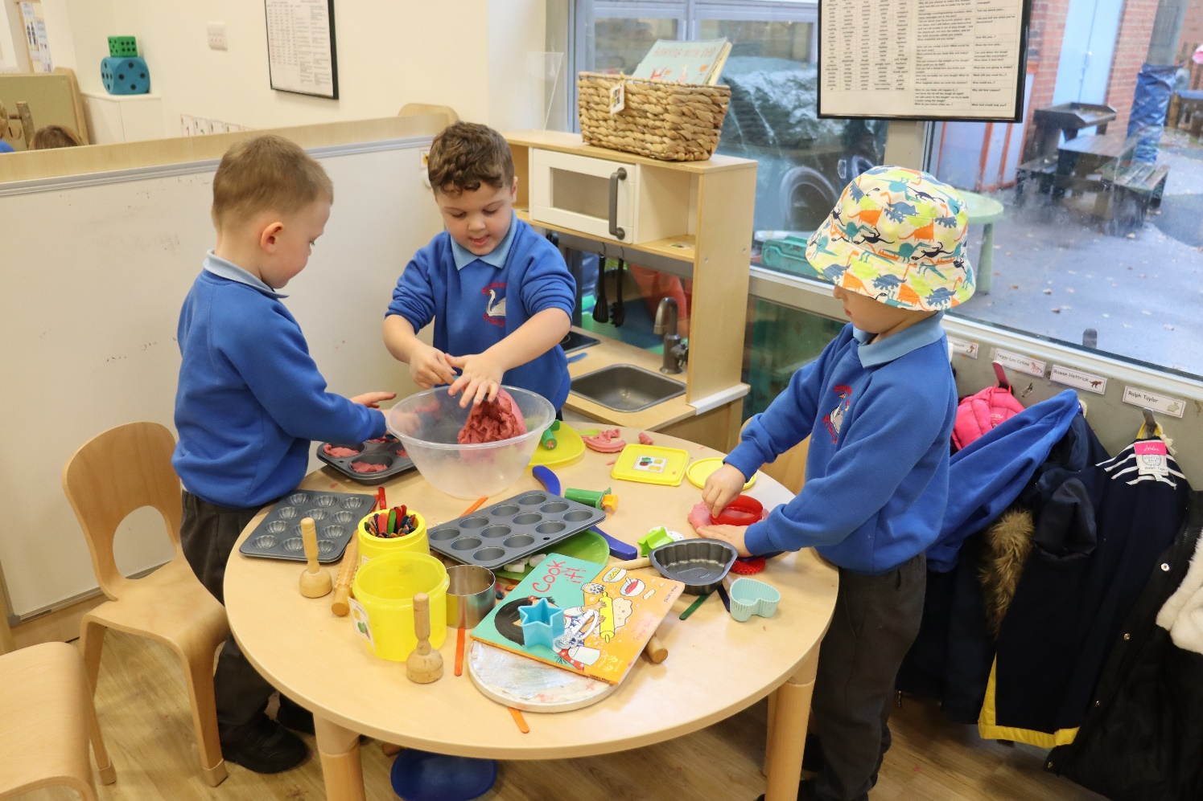
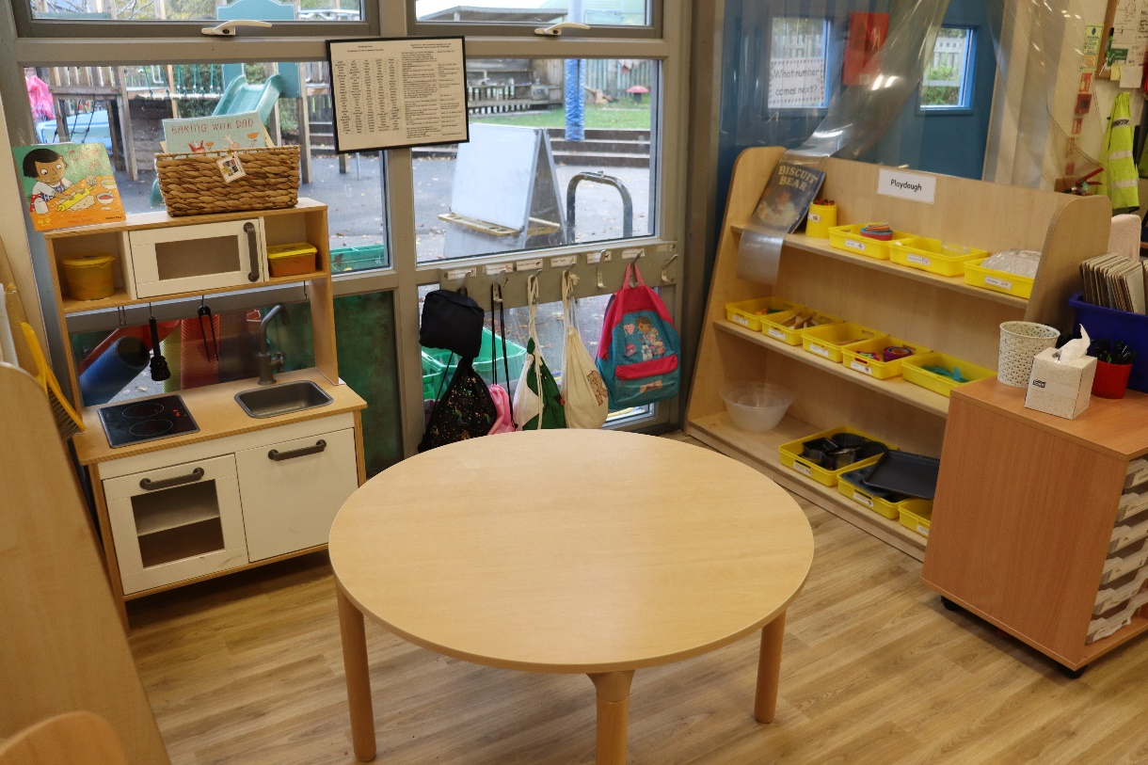
The Playdough Table
The playdough area appeals to children's creativity. There are plenty of opportunities for imaginative role play alongside shaping and cutting the playdough. This area offers communication experiences and also helps the children develop collaborative play. In addition, developing the children's fine motor skills will help them with their pencil control.

Slide 10
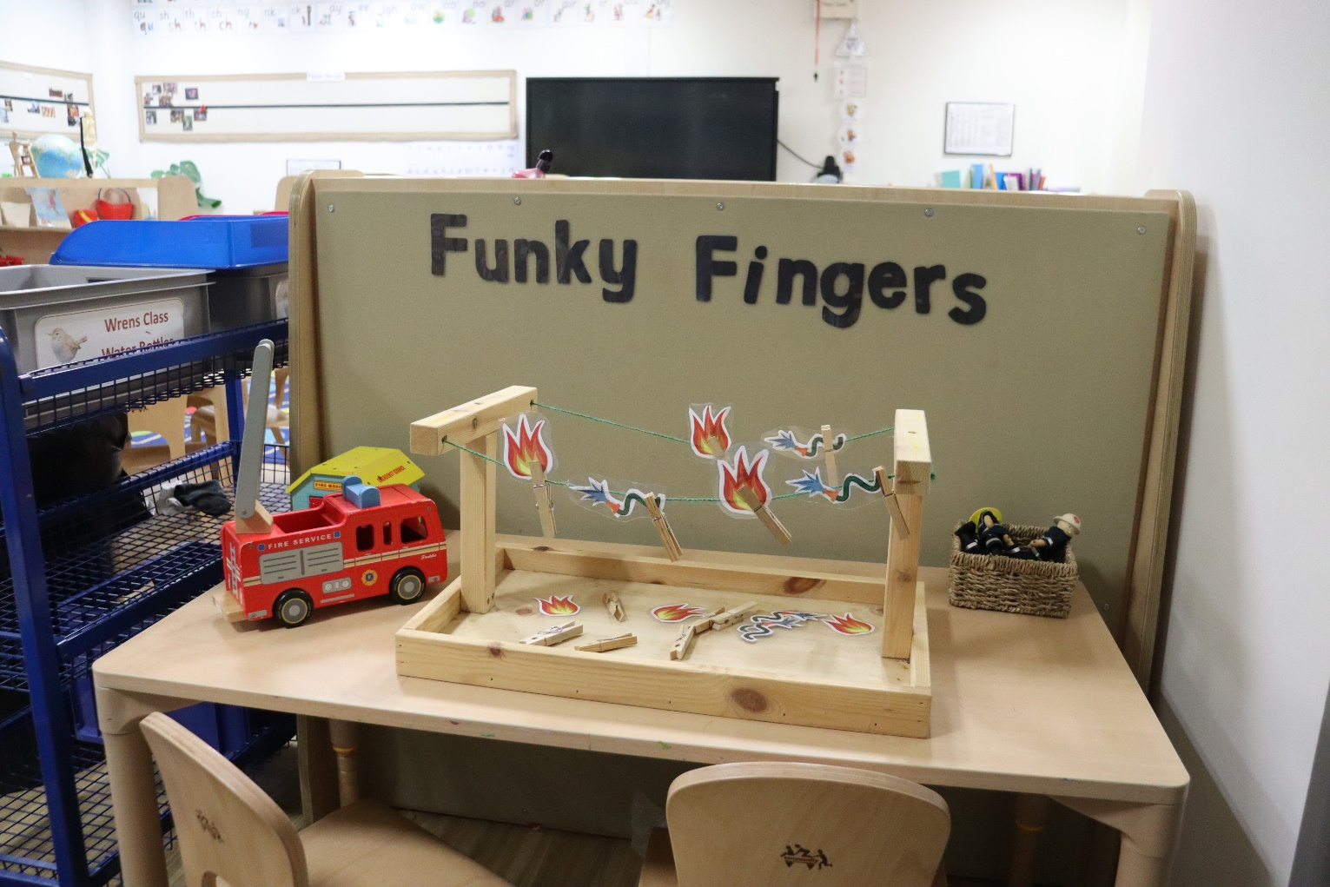
The Funky Fingers Table
The Funky fingers table is designed to encourage the children to develop their fine motor skills. A table top where children can gather around all sides to work on the activity whilst promoting language skills and resilience.

Slide 11
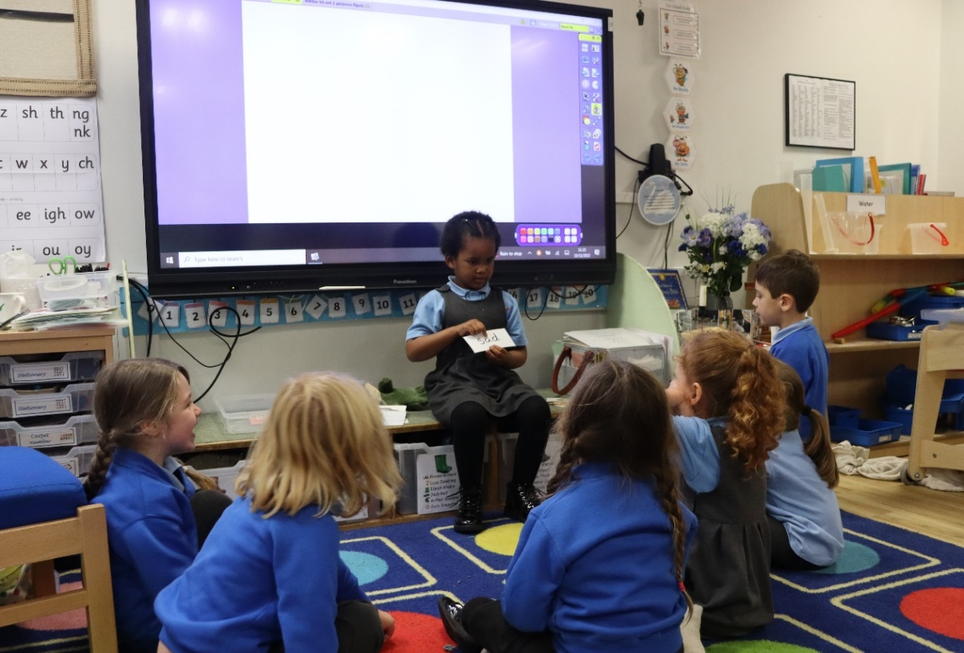
The theory behind our new classroom environment:
Our Early Years provision is comprised of two classrooms and a natural outdoor space. The unit has been planned thoughtfully, placing specific areas alongside each other to support children’s play that may naturally spill from one area to another. Children have full access to the entire unit during our learning and playing time, allowing both classes to socialise and enjoy the spacious and carefully considered resources, which supports their learning and development. We believe the children benefit from playing and learning alongside their peers in the whole cohort and developing friendships across both classes. The adults work as a team to teach all the children in the year group although the teachers and TAs are ultimately responsible for the children in their class.

Slide 12
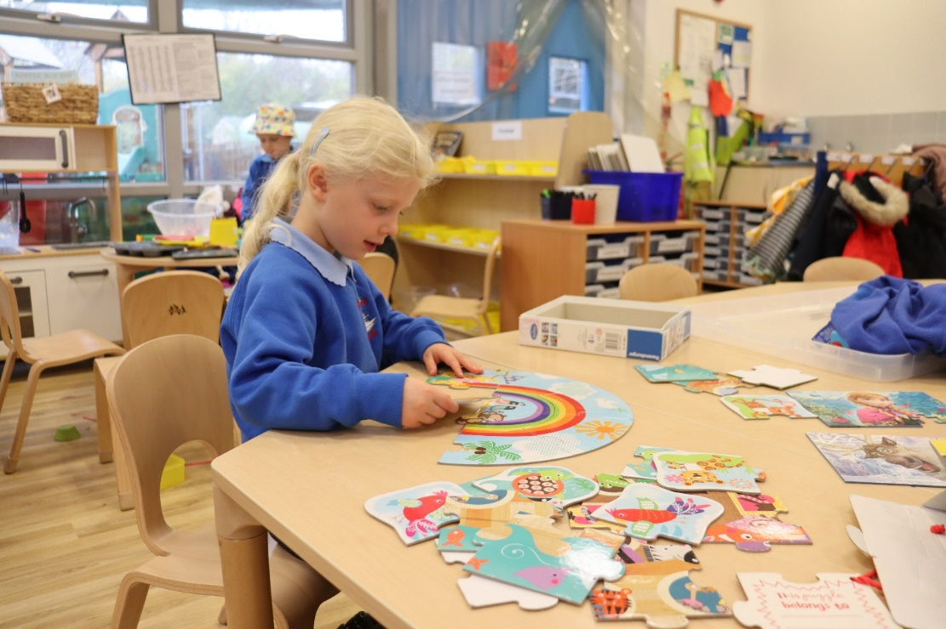
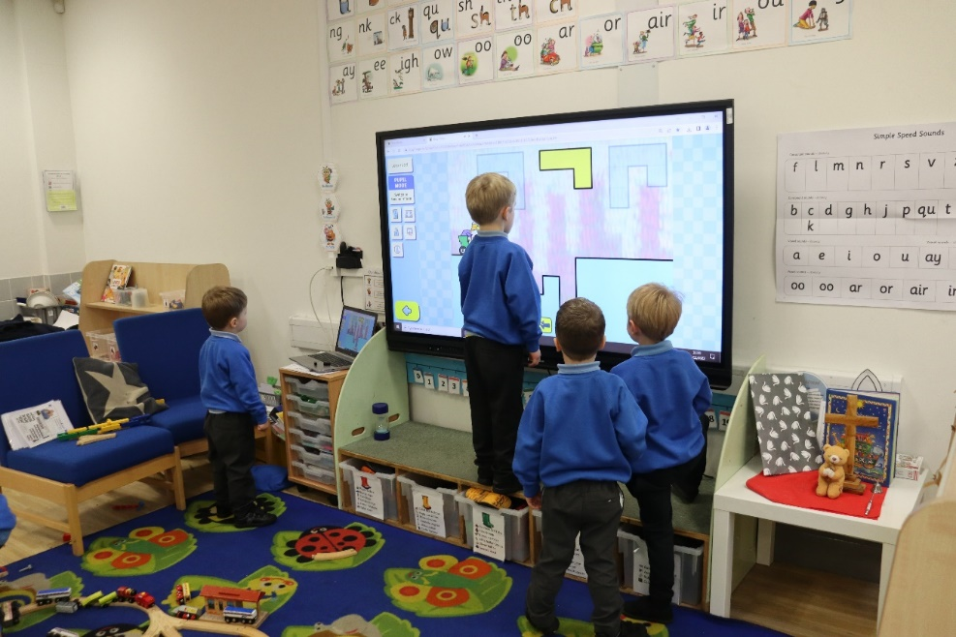
As well as providing storage for resources at child height, the shelving creates partitioning effects where corners are used to screen off areas in order for the children to focus on the activity they have chosen, without the distraction of seeing alternative play opportunities. When children are given too much choice they flit between activities without becoming deeply involved. The size of the area will also dictate the number of children able to play in that space. This helps more purposeful play opportunities to develop and also leads to a better environment for language and communication. Some specific areas are near to each other so that there can be an element of the play in one area naturally spilling into another, for instance small world and block construction.

Slide 13
Although children are free to choose where they wish to play there are boundaries to maintain control and ensure that the learning environment enables productive play opportunities. Children are not allowed to move resources from one area to another and are taught to tidy up an area once they have finished their play. The boxes and shelving are clearly labelled to aid independence when selecting resources and when tidying away. This in turn helps with mathematical reasoning, sorting and reading. We are aware that sensory activities like sand, water, playdough and creative activities like role play, construction and small world are naturally more engaging for young children and that adults will have to work harder to promote the maths and writing areas which are not so immediately accessible. The maths and writing areas are fed by the children’s experiences in the sensory and creative areas, so careful consideration has been given to the location of these two areas. Reading is promoted by high quality texts throughout the areas, some of which are there permanently but many will change with topics and seasons. Mark making is also encouraged throughout, with whiteboards, blackboards, and pin boards in addition to clipboards and mark making books.
The classroom environment is designed to arouse interest and curiosity without overstimulation. For this reason, there is a deliberate choice to reduce the amount of colour and retain a sense of structure, avoiding the temptation to offer too much choice (less is more), creating a more peaceful impression.

