Slide 1

My God is my strength in whom I trust

Slide 2
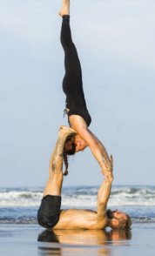
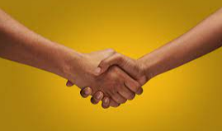
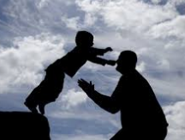
What does trust mean to you?

Slide 3
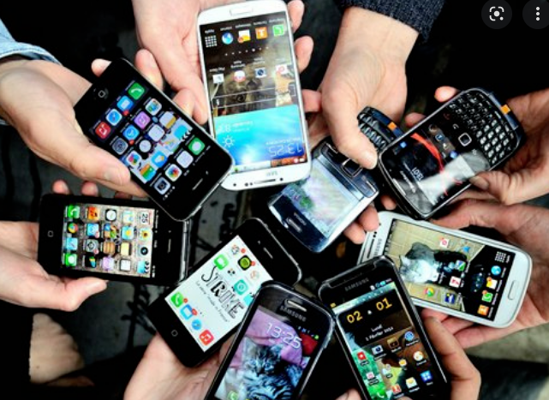
Why are mobiles so important to people?

Slide 4
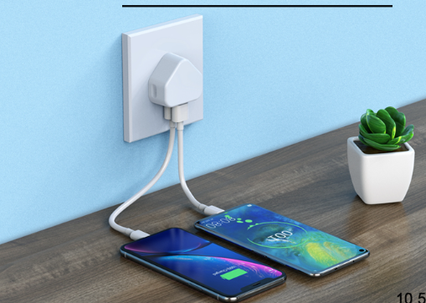

Slide 5
How do you like to relax and rest?

Slide 6
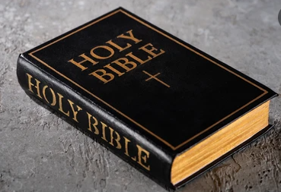

Slide 7
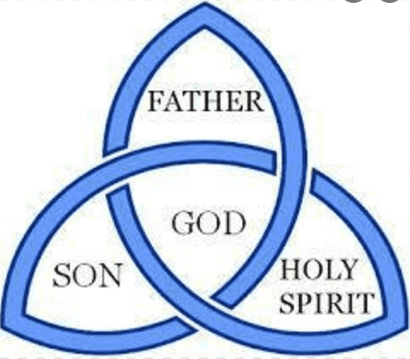

Slide 8
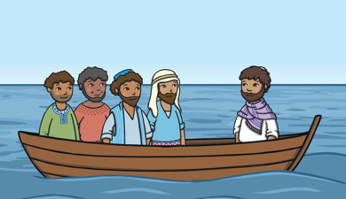
Jesus calms the storm

Slide 9
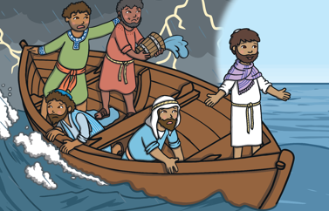

Slide 10
Time for reflection
Think about the question that the disciples in the boat asked each other:
‘Who is this man who has
the power to stop the waves?’

Slide 11
Who do you consider
to be powerful?

Slide 12
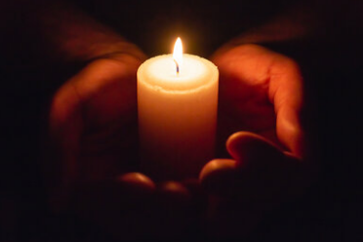

Slide 13


